Slide 1
A TradItIonal TurkIsh Sport Matrak
Ali Ergüden

Slide 2
TRADITIONAL TURKISH SPORT MATRAK
Traditional Turkish Ancestral Sport Matrak was taught to the Janissary, Sipahi and Ottoman public by renowned Turkish scientist Matrakçı Nasuh (1480-1564) as a Battle and Combat Art and practiced for centuries. Matrak game is a sport adopted as a scientific branch in Turkish history
Matrak aims to raise brave, virtuous, qualified and knowledgeable sportsmen.

Slide 3
The History Of Matrak
Matrak game was taught to Ottoman soldiers by Matrakçı Nasuh with new technical games added. According to notes from the Travel Book by Evliya Çelebi, Sultan Murad IV learned 70 techniques of the game. With the reforms in the military system of the Ottoman army in the 19th Century, Matrak game was forgotten.

Slide 4
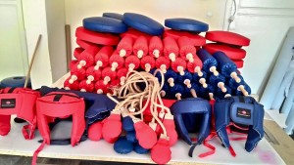
Matrak Materials
“Matrak” Stick, “Kalkan” Soft Pad Shield, “Miğfer” Helmet for Head Protection, “Aba” Sportsman’s Dress, “Tomak” tool, “Kılıç” Stick/Machete with protection in the form of Turkish sword, “Zırh” Body guard Armor, “Kolçak” Hand and Arm Protection Armbands, “Dizçek” Foot and Knee Protection Knee Guard and “Kagi” Groin Guard materials are utilized.

Slide 5
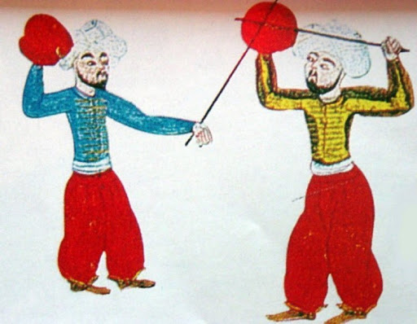
The Benefits Of The Matrak
Sportsmen who receive Matrak training learn Turkish culture and social ethics tenets within a natural learning process. Socializing with an entertaining training method, sportsmen also receive benefits to their mental development with creating tactics playmaking structures existing in the Matrak teaching.

