Slide 1


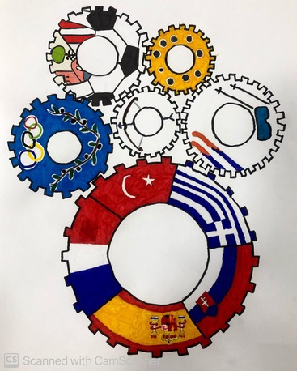


Hilda
Múdra
WOMEN IN SPORT
Figure skating

Slide 2
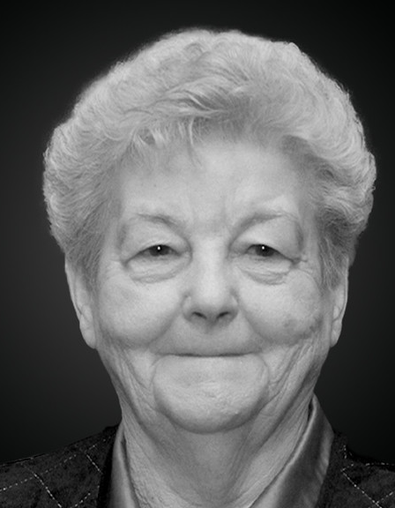
Hilda Múdra
Coach of Ondrej Nepela, three-time world champion and five-time European champion in figure skating.
She also trained Miroslav Šoška, Jozef Sabovčík, Marian Filc, and others.
AWARDS:
International Olympic Committee Ethics Award (1998)
IOC Olympic Gold Circle (2000)
Pierre de Coubertin Award (2003)
2021 - Ludovít Štúr Order of the First Class for exceptional merit in the field of sport and for exceptional promotion of the good name of the Slovak Republic abroad

Slide 3

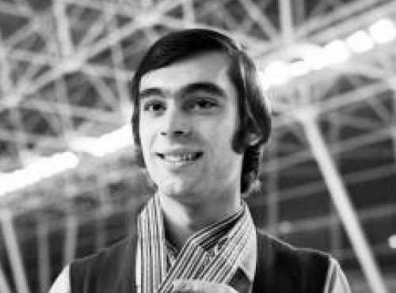
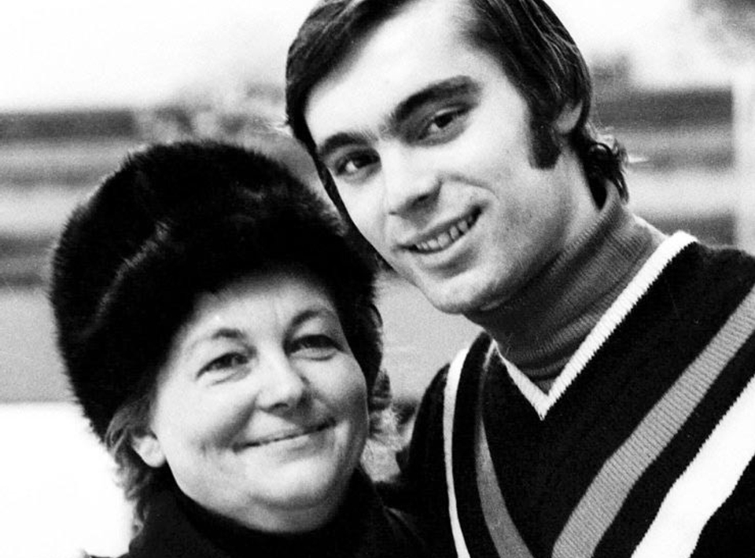
Ondrej Nepela's coach
She trained him from 1958 until the end of his career in 1973.
Successes:
Olympic victory in Sapporo
three world championship titles (1971-73)
five European champion titles (1969-73)
eight titles of the champion of the Czechoslovak Socialist Republic.

Slide 4
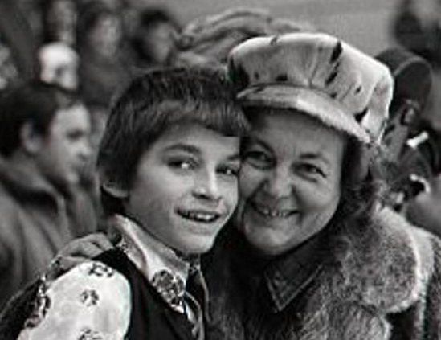
Coach of Miroslav Šoška
He won silver medal at Prague Skate 1977
Bronze medal at Rotary Watches International 1978 .
His best result was eighth place at the 1978 European Championships in Strasbourg.

Slide 5
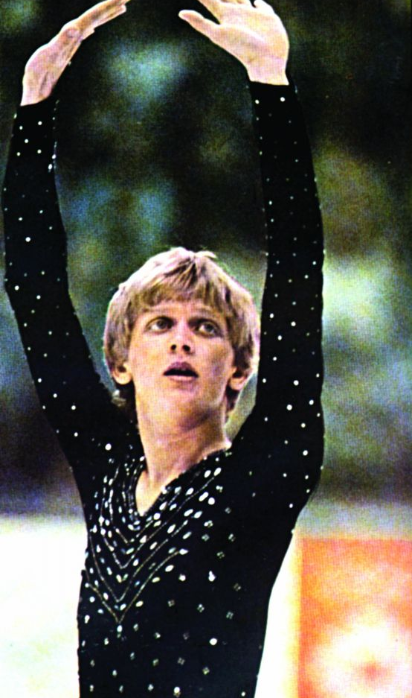
Coach of Jozef Sabovčík
He won six Czechoslovak champion titles.
He became two-time European champion in 1985 and 1986
He finished fourth at the 1984 and 1985 World Championships.
The highlight was the Olympic bronze medal at the 1984 Winter Olympics in Sarajevo.

Slide 6
Hilda Múdra´s trainees successes:
Sandra Dubravčičová
Agnesa Búřilová
Eva Grožajová
Marian Filc
European silver
at the 1964 Winter Olympics she finished 9th
ME Bratislava - 8th place,
in 1960 she finished second at the Winter Universiade
bronze at the 1961 World Championships and silver in the following two years
ME Västerås - 7th place,
Winter Olympic Games Grenoble - 10th place

Slide 7
Sources:
https://sk.wikipedia.org/wiki/Hilda_M%C3%BAdra
http://www.jumpingjoe.sk/hilda-mudra/
https://sk.wikipedia.org/wiki/Ondrej_Nepela
https://en.wikipedia.org/wiki/Miroslav_%C5%A0o%C5%A1ka
https://www.vtedy.sk/nezabudnutelne-krasocorculiarske-hviezdy-na-bratislavskom-lade
https://sk.wikipedia.org/wiki/Agnesa_B%C3%BA%C5%99ilov%C3%A1
https://cs.wikipedia.org/wiki/Eva_Gro%C5%BEajov%C3%A1
https://sk.wikipedia.org/wiki/Marian_Filc

Slide 8
Mária Sofia Kováčová
Stredná Zdravotnícka Škola Moyzesova 17, Košice
kovacovamariasofia@gmail.com

