Slide 1
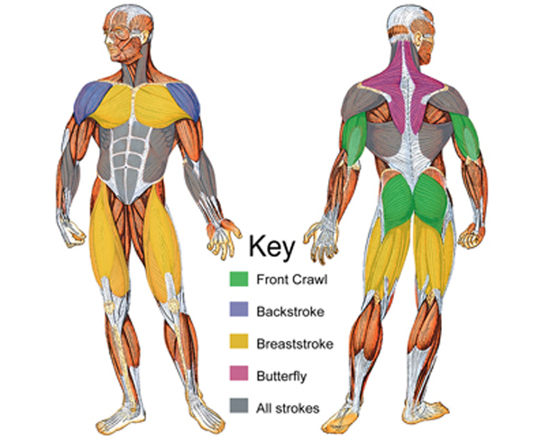
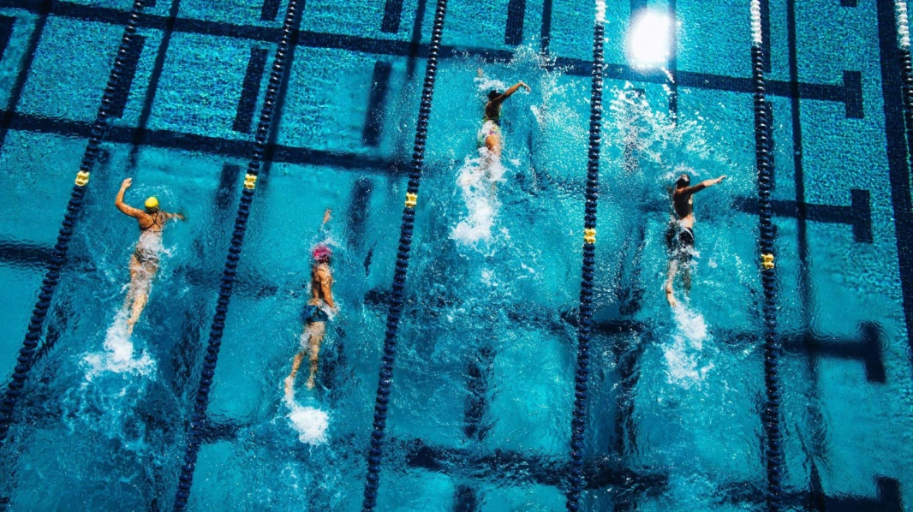
Muscles Used İn Swimming
Muscles developed by swimming:
Core abdominal and lower back muscles, deltoid and shoulder muscles,
forearm muscles, upper back muscles,
glutes and hamstring muscles are muscles used in swimming.

Slide 2
Latissimus Dorsi
* The latissimus dorsi muscle or commonly known as “lats” are your middle back muscles. If you push your hands together in front of the lower part of your chest, you will be able to flex your latissimus dorsi muscles.
These muscles play a large role in your ability to pull. You will flex and use these muscles from point of water entry all the way until your hand is just past your chest, at which point your pull becomes dominated by your tricep.

Slide 3
Tricep Muscles
Pectoral Muscles
The tricep muscles or commonly known as “tri” are the muscles in the back part of your upper arm, opposite of your bicep. Your tricep is used to finish your pull in freestyle stroke, backstroke, and butterfly.
The tricep muscle is what gives your pull the final push and allows you to complete a full stroke to your hips. Without the strength to finish your pull, you will be required to complete more strokes which will slow you down.
The pectoral muscles is a fancy term for your chest muscles or more commonly know as “pecs”, which play an integral part in freestyle stroke and breast stroke. This muscles helps stabilize your strokes so does not contribute a large amount of strength to your propulsion.
One of the best exercises to work your chest muscles is by bench pressing. This can be performed by laying on a bench and starting with a bar above your chest, then slowly bringing it down to your chest and back up again.

Slide 6
Butterfly
Butterfliers have the arms. Their triceps are toned, their biceps are ripped, and they have some seriously large shoulders. While the undulation relies primarily on the abs and hips, butterfliers focus their efforts on the catch starting with their hands and ending at their lats, allowing the rest of their body to flow through the water.
Butterfly requires the fullest whole body muscle engagement out of the four strokes and the most arm muscle engagement per stroke cycle. While butterfliers often complete less stroke yardage than their counterparts, their high intensity training promotes toned muscles throughout the body.

Slide 7
Backstroke
Backstrokers are known for their firm pecs, thighs, and glutes. To keep themselves afloat, backstrokers rely heavily on their chests and midsections. An elite backstroker may appear to be effortlessly moving through the water, when in reality, the swimmer is subconsciously engaging each of these muscle groups. Backstrokers’ lower physical cognizant awareness allows them to continue for long periods of time at high cadences with comparatively low fatigue.

Slide 8
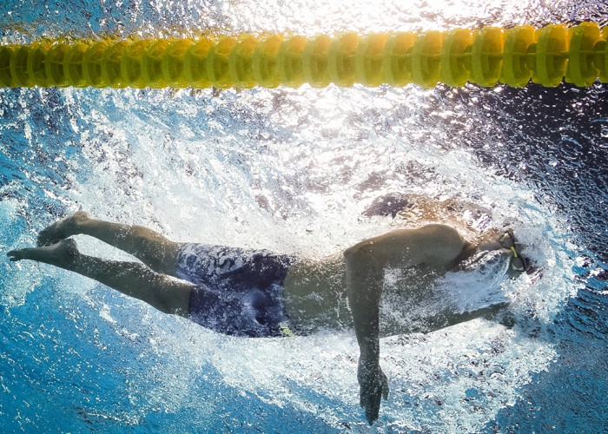
Freestyle
Freestylers have the hips, hands, and feet. The stroke’s long axis rotation makes it ideal for tall people and even better for tall people with large appendages. Freestylers’ hands act as paddles while their bare feet often resemble the size of a stroker’s fins. Following the initial catch, freestylers rely on the largest muscle groups of the arms and legs to propel them forward.

Slide 9
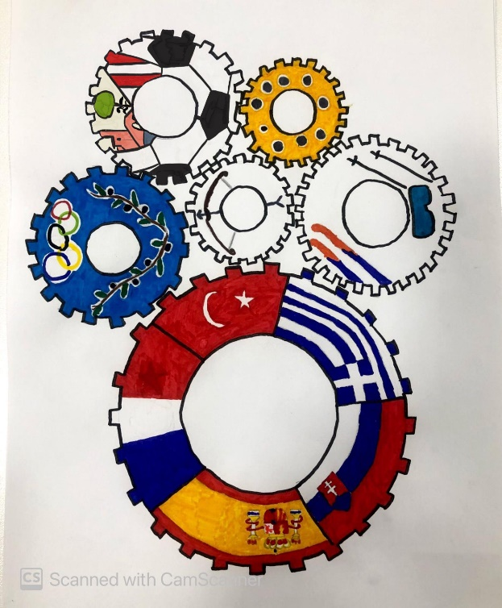
I am a good swimmer and I have some medals
I like swimming butterfly because it is the hardest one and makes me stronger and a good swimmer.
Thank you for listening me.
Ali ERGÜDEN

