Slide 1


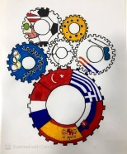

Women in Sport
Zuzana Žirková

Slide 2
Curriculum vitae
is a basketball legend, a former Slovak basketball representative participating in the Sydney 2000 Olympic Games
During her sporting career, she played in several Euroleague clubs and in 2003 at the WNBA for the Washington Mystics
She became the best scorer of the International Basketball Association of the FIBA ​​category under the age of 20, three times the Euroleague champion, twice the sSCP Ružomberok, and eight times the best player in Slovakia. She ended her playing career at Good Angels Košice.
She is currently the coach of Young Angels Košice.

Slide 3
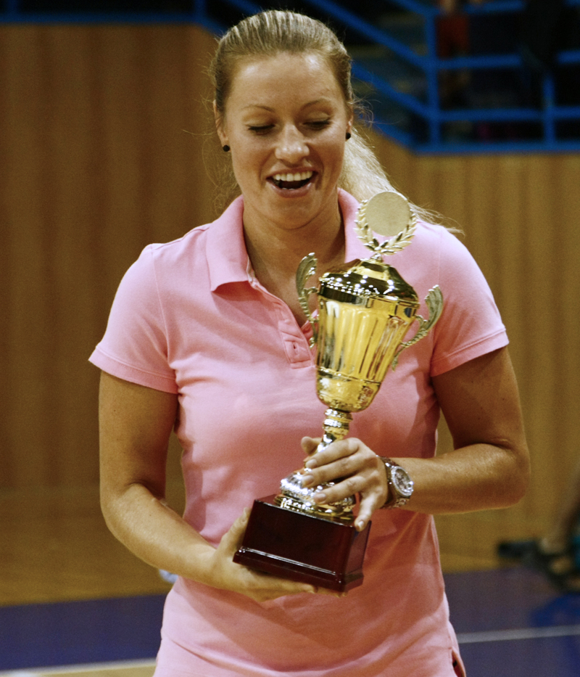
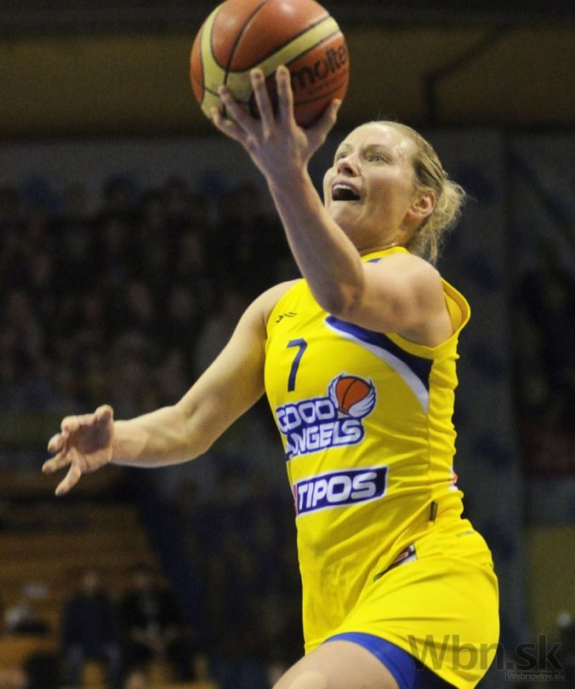
Player career
In 2017, Žirková participated in the European Women's Basketball Championship, where Slovakia finished in 8th place.
was the best Slovak in the tournamentsvoju
after the championship she definitively finished her national team work (after announcing her national team end twice, in 2011 and in 2015).
She ended her playing career in April 2018 after winning the 15th league title of the Good Angels Košice team

Slide 4
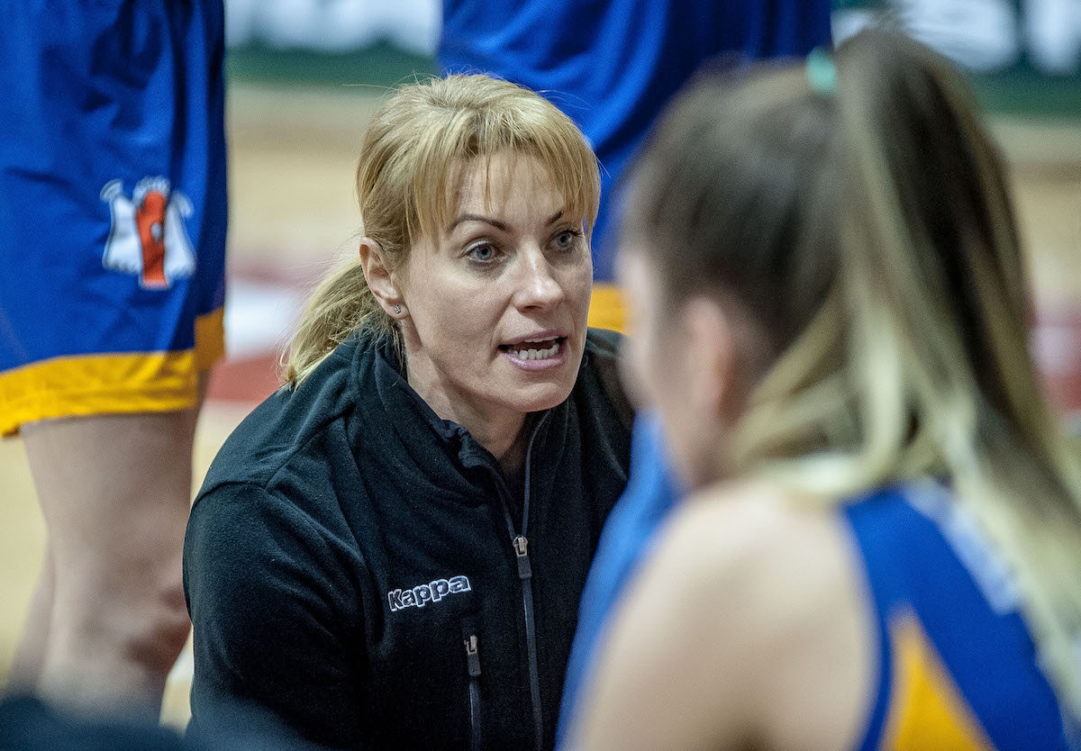
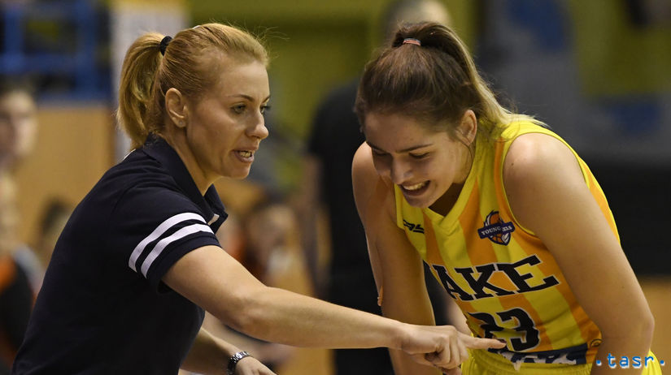
Coaching career
In the 2018/19 and 2019/20 seasons, Žirková worked as the head coach of the Young Angels Košice team
She finished with the team in 2019 in fourth place and in 2020 after the early end of the coronavirus pandemic season in third place
Subsequently, she started to play men's basketball, from August 2020 she started working as an assistant coach in the BKM Lučenec team.

Slide 5
Greatest achievements
8x the best basketball player in Slovakia
17 national titles
3 European League titles (SCP Ružomberok 1999,2000, Gambrinus SIKA Brno 2006)
2006 - 8th best basketball player in Europe
36 points - shooting maximum in the official national team qualification qualification for the European Championships 2005, Slovakia - Latvia
2003 WNBA - Washinghton Mystics

Slide 6
Greatest achievements
Olympics in Syndey 2000- 7th place with a personal average of 10.7 points per match
best FIBA ​​shooter under 20 in 2000
European Junior Championships Turkey 1999- 2nd place
World Cup Brazil 1997- 3rd place
EC Žilina 1996 up to 18 years - 2nd place

Slide 7
Work in clubs and the number of national titles
Good Angels Košice 2014 -2018 5 titles
UMMC Ekaterinburg 2011 (3 months) 1titul
Good Angels Košice 2010-2011 1titul
WNBA Washimgton Mystics 2003
Gambrinus SIKA Brno 2002-2010 7 titles
GYSEV Ringa Sopron 2000-2002 1titul
SCP Ružomberok 1998 -2000 2 titles
Delta Košice 1996-1998

Slide 8
Thanks for paying attention

Slide 9
Zdroje
Víťaz je v každom z nás ,ISBN :978-82-8180-179-2 ,TAKTIK vydavateľstvo , s.r.o
https://hkkosice.sk/fanusik/rozhovory/zuzana-zirkova-2/
https://sk.wikipedia.org/wiki/Zuzana_%C5%BDirkov%C3%A13.10.2021

Slide 10
Martina Plachetková
plachetkova.martina4@gmail.com
Stredná zdravotnícka škola, Moyzesova 17 Košice
II.FL
2021/22

