Slide 1
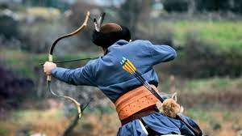
Turkish Archery

Slide 2
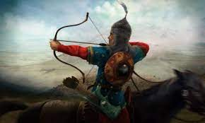
Archery is given great importance in the "Mounted Steppe Culture", which emerged in the Altay and Tanrı Mountains and its surroundings since about 5000 BC and then dominated Central Asia completely. Arrow and bow take place with symbolic meanings in the Oğuz Kağan Destanı, one of the Turkish epics.

Slide 3
Archery has had a wide importance in the history of Turkish culture. Apart from combating, hunting and sports, archery has also become important in the social field.
For example, various sports archery competitions took place in social life during military holidays, religious ceremonies. Anna Komnini; «"If a Turk has started to chase, he rights his enemy by shooting arrows. If he is chased, he will prevail thanks to his arrows. The arrow he throws will fly into a horse or a horse. If the arrow is stretched with a very strong hand, it pierces the body.»

Slide 4
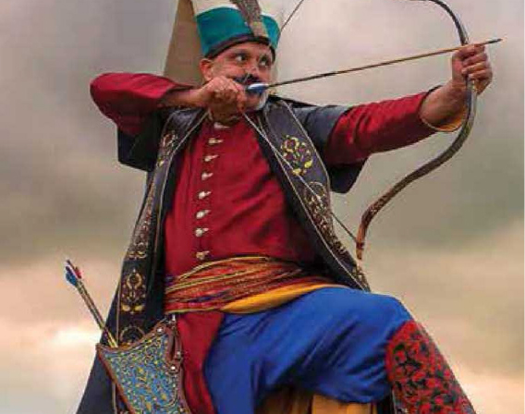
In Turkish history, arrows were used not only as tools of war, but also in symbolic meanings.
and of course, there are many important archers in the history of Turkish archery. One of them is Tozkoparan İskender. Tozkoparan Iskender is one of the greatest archers in Turkish archery history. He broke 10 separate records in various provinces of the Ottoman Empire, after which these records could not be exceeded. Tozkoparan İskender broke his longest record with 1281.5 excursions in Akrurı Range, which is set in the sunrise. This distance of 846 (or 848) meters is a world record.

