Slide 1
INTERWIEWING WITH A SPORTSWOMAN

Slide 2
Can you tell us about yourself?
My name is Merve Nezir. I’m 24 years old. I’m a Professional volleyball player. I’m playing at Karayolları Sports Club right now.

Slide 3
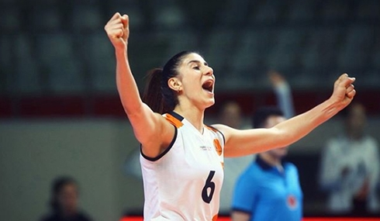
How did you become a sportsperson?
I had a physical education teacher when I was your age. I started playing volleyball with his guidance. They invited my parents to school and guided me to become a volleyball player.

Slide 4
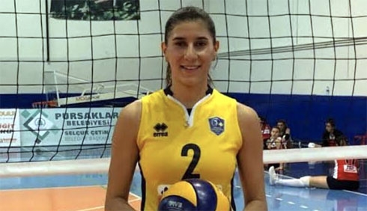
How long have you been doing this sport?
I have been playing professionally for 7 years. I quit because I wanted to focus on my lessons for a semester. Then I came back again at high school. I started my professional volleyball career in Izmir.

Slide 5
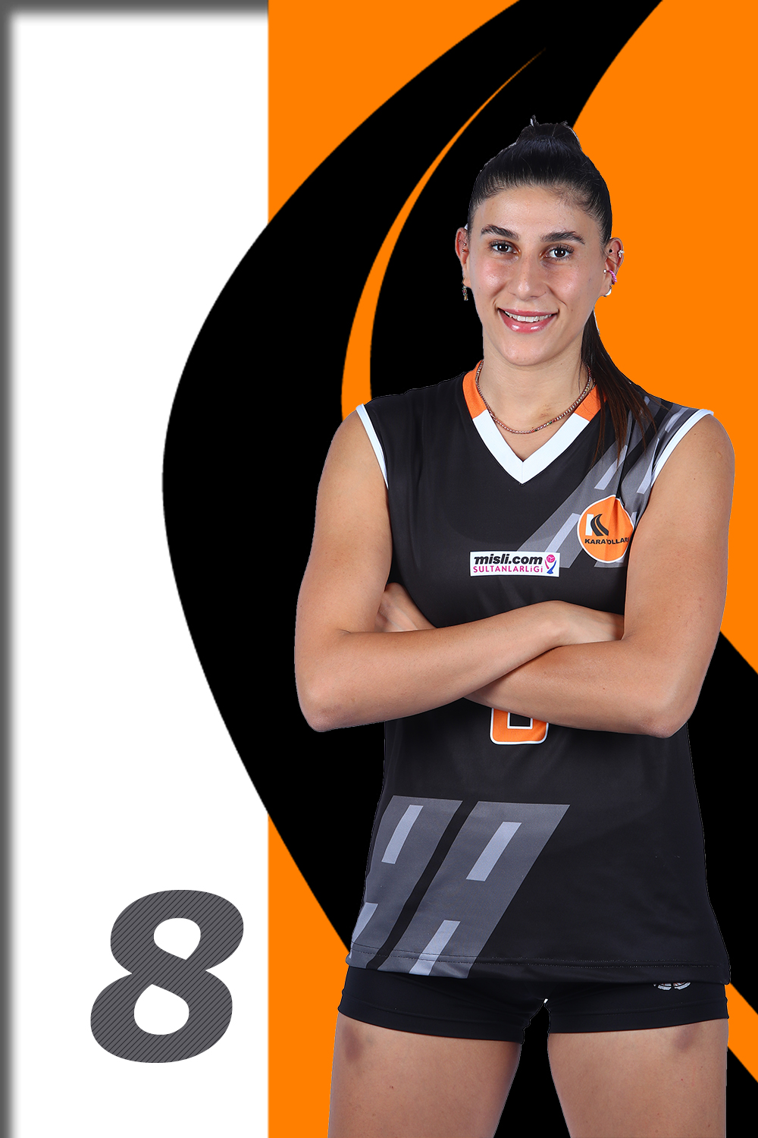
How did your family react when she found out about your sports career? Did they support you or remind you of its difficulties?
Since there were no athletes in my family, they didn't have much information. Despite this, they have been very supportive. For example, they used to take me to gym. However, after a certain time, I took responsibility and started going alone. Thanks to this, I also learned to take care of myself.

Slide 6
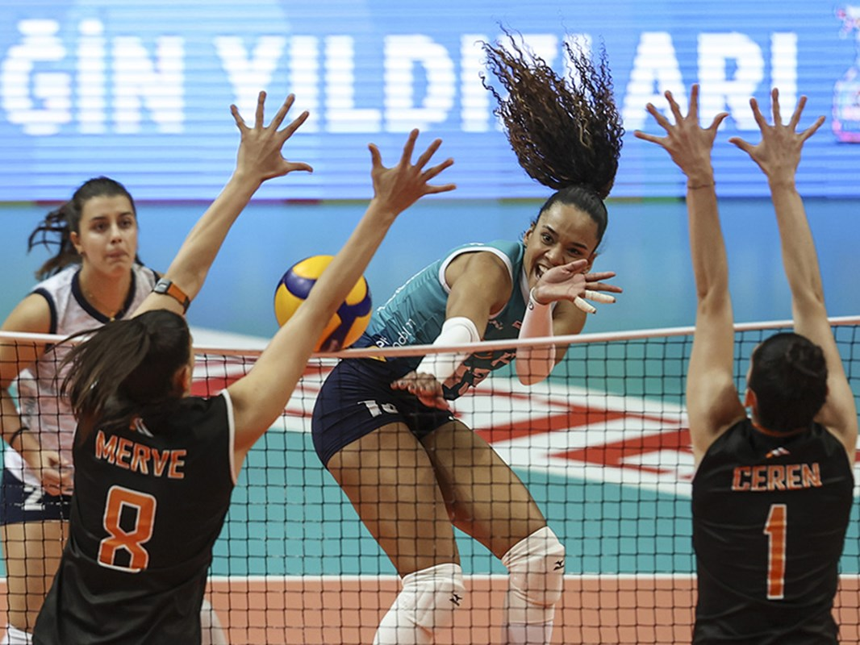
What are your plans for the future?
Because I play volleyball, every season, we prepare for the next season. So I can always say that I want to train well, go to matches and perform at my best and play in a better team for the next season.

Slide 7
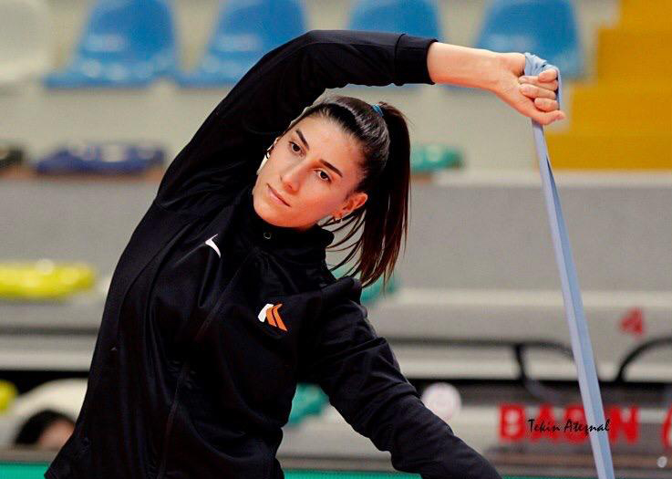
Do you have some recommendations for children?
You are very lucky to be in such a school at this age and to have been educated by people who know the sport. That's why I always recommend that you study. My advice to you is to study hard for your classes, even if you are in sports. Because when you study hard, you always achieve something.

Slide 8
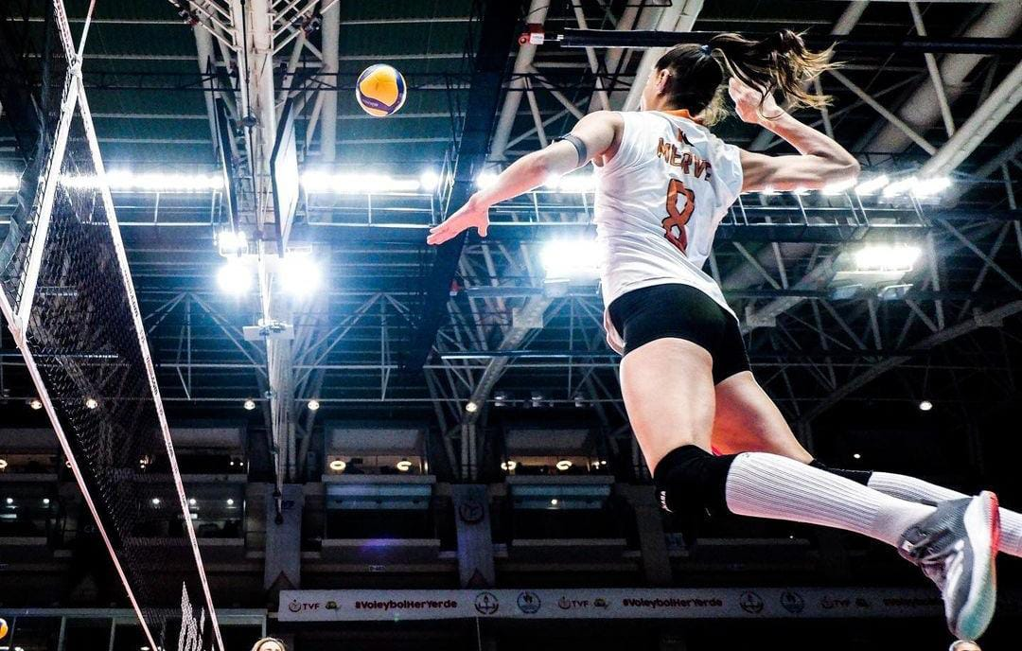
What do you think of the importance of "women in sports" in our country?
I think that as women athletes, we have proven the place of women in sports in our country. For example, our women's national volleyball team has achieved great success at the Olympics. We hear their voice more and more on TV, they play in commercials. I think we have showed the woman's strength on the field and proved ourselves to people.

Slide 9
Have you been discriminated against just because you are a female?
I can't say that for sports. I think I'm even more privileged because I'm a woman. For example, our women's national volleyball team is very successful, so women are at the forefront.

Slide 10
Do you feel that you are equal with male athletes?
I think yes, women have equal rights and even more at the forefront than me in terms of volleyball. They have been much more successful and have achieved more success internationally.

Slide 11
Do you feel that if you become a mother, would you need to quit sports?
No. In fact, there are many examples of this. For example, there is an athlete named Naz Aydemir Akyol in the women's volleyball team. For example, she is an athlete who has played on qualified teams for many years. She had a child two seasons ago, she didn't play for a season. She returned the other season. So it all depends on the athlete's desire.

Slide 12
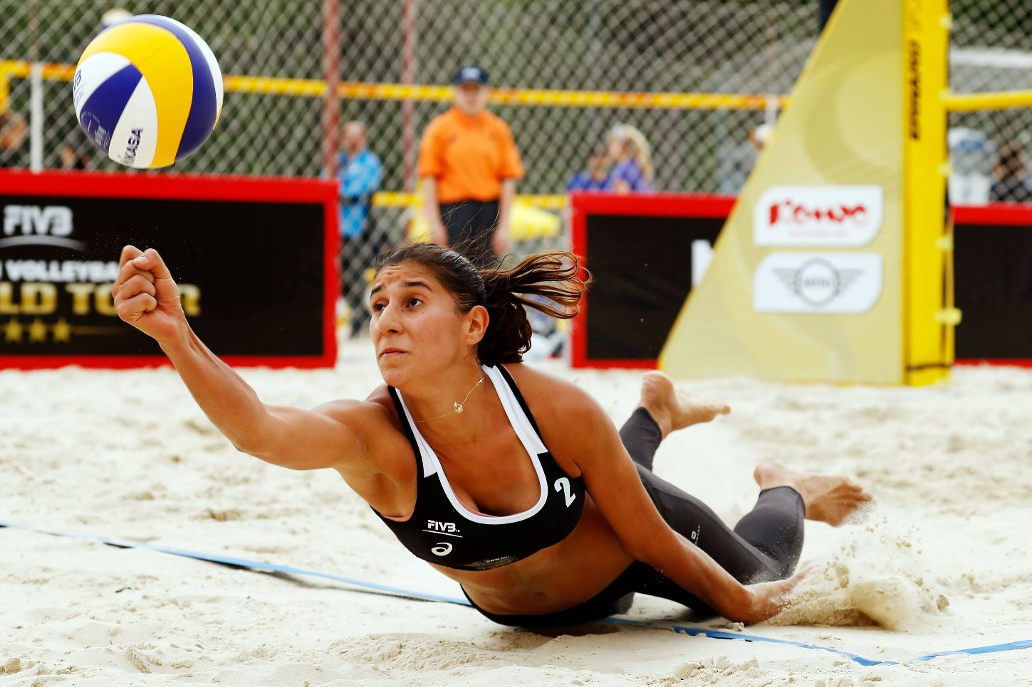
Do you think that the young girls are given enough opportunities to improve themselves?
It's a great possibility that you can even study at such a school right now. For example, I would really like to be in your shoes right now and have a professional athlete come to my school and learn something from her. Besides, there are a lot of sports schools now. With a little research, you can see all the possibilities.

Slide 13
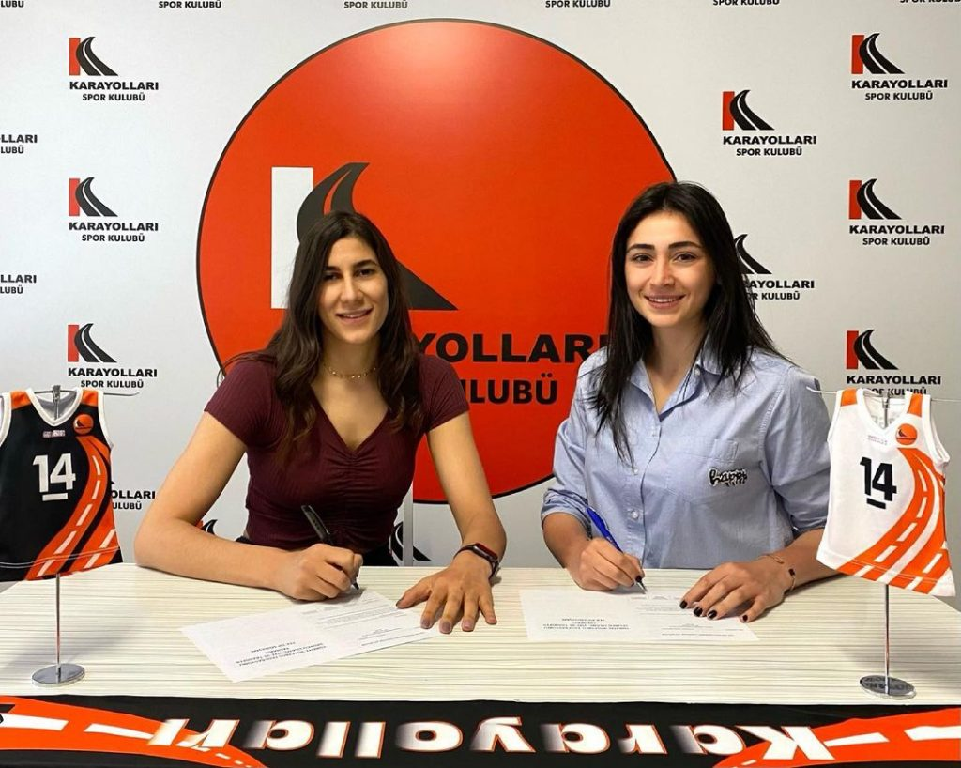
Does being a women athlete have any advantages? If so, what are they?
For example, when I go somewhere, I have a lot more say in my athlete identity. I meet a lot of people and travel a lot. For example, I have just met you and I have a voice here. It's a great privilege to be able to pass something on to someone. It's a great privilege if I can pass on my experience to you right now.

Slide 14
What sport would you do if your current sport didn't exist?
I really like watching tennis, I would love to play tennis.

Slide 15
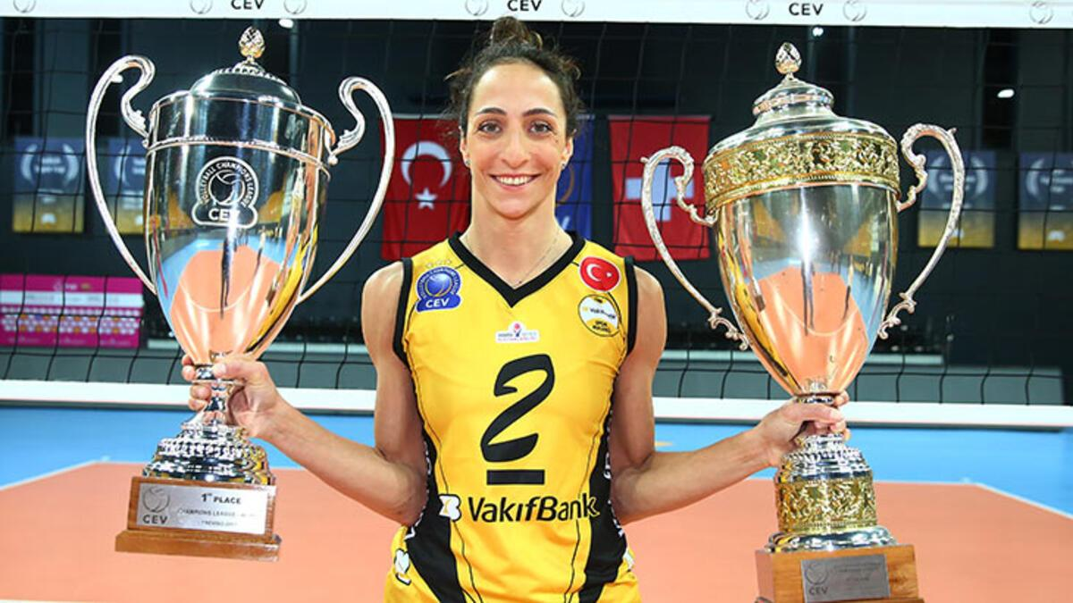
Who is your female idol? Can you give a brief information about her?
I think every athlete has a role model. Mine is Gözde Kırdar. She quit volleyball at the moment but she was one of the best corner players of Turkish volleyball. I'm also a cornerback, I always take her as an idol and I still watch her videos. In addition, the league I play in is called the Sultans league. We are currently playing in a league where the best volleyball players in the world are playing. I get the chance to play against players I like very much.

Slide 16
What would you do for a living if you didn’t become a volleyball player?
I would like to become a dietitian. In fact, that's why I'm currently studying nutrition and dietetics.

