Slide 1
ÇÖĞEN
Turkish ancestor sport

Slide 2
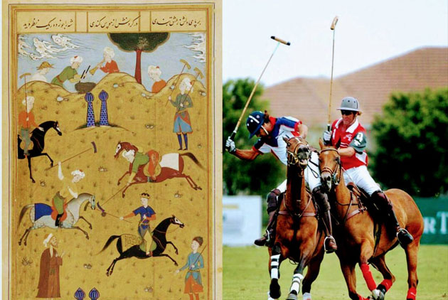
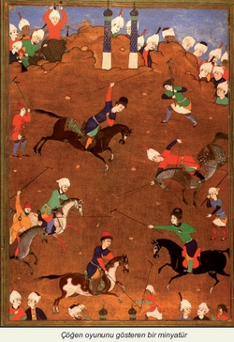
Now let me introduce to you çöğen, the ancestor sport of the Turks.
General View Of Çevken / Çöğen / Çevgan / Polo Game In Turkish Societies From ThePast To The PresentThe folklore of the “çevgen / çöğen / çevgan / polo” game, as well as its origin, source, geograpic distribution, terminology and new dimensions, which were unknown before, were investigated in this study. Even though çögen is one of the traditional Turkish riding sports, its origin was wrongfully attributed to Persia in most international literature. Some of the Russian literature, especially the Central Asian related ones, indicated in many ways that during the ages where life was centered around horses, çöğen / çevken was the result of “steppe – horse based Turkish culture”. The aim of this study is to define the position of “çöğen” in the socia-economic and cultural lives of the Turkish communities, to correctly

Slide 3
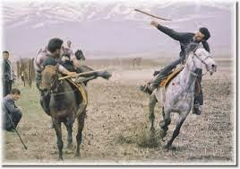
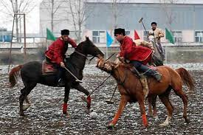
in the continuation
To reflect the history of Turkish sports and to strengthen the role of the Turks in the history of sports and to place the “centipede” where it deserves. This game was played for the first time in 841 and 946 in Yenisey and Issık Kök and later in all other Turkish states. Although the records about Çöğen are found in major Turkish literary records and medical books, this play cannot be seen in Turkish mythology. The same authors put mythology before great literary records. It has been noted that with the decreasing role of the horse, the cöğen, which it previously carried out in Turkish societies, lost many of its functions.

Slide 4
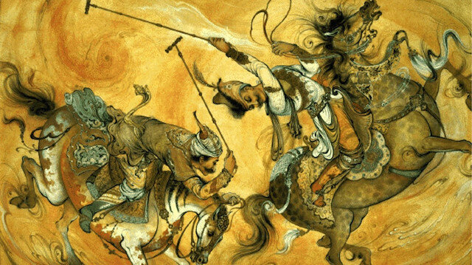
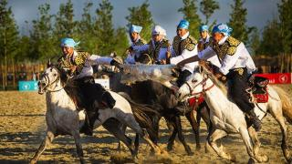
IN THE CONTINUATION
Which it had previously executed in Turkish societies. Consequently, the game was played less and less and was slowly being forgetten. Polo played in Istanbul by the British in 1912, was not played in Turkey since. It was recorded that this game was played in Frunze/Bişkek with the name of “çevken” in 1972. Today, it is played in Southern Turkistan and known as “çevken”, “gil-git” or “pulu”. With its modern name, “polo” is continued to be played by wealthy high-class society.

Slide 5
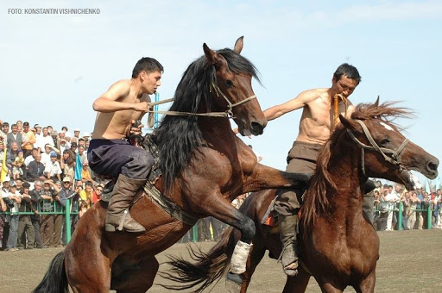
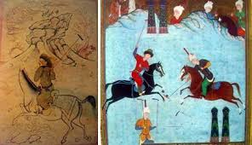
THANK YOU FOR WATCHING THIS SLIDE

