Slide 1
KOŠICE

Slide 2
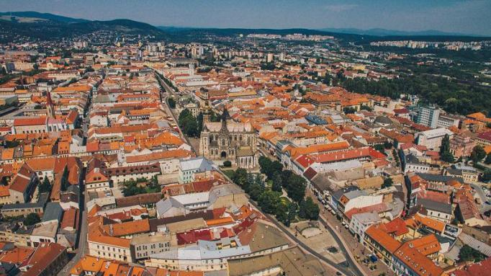
Basic information
Košice is the second-largest city in Slovakia
It is the largest city in eastern Slovakia
Its area is 243,7 km
Almost 240 000 people live there
Density of population is 982,8 people/km2
The Hornád river flows through the Košice

Slide 3
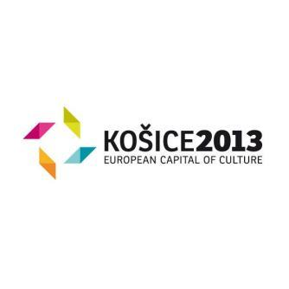
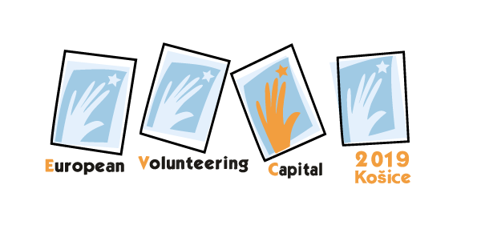
Succeses of the city
In 2013 Košice was the European Capital City of Culture
In 2016 Košice gained title the European City of Sport 2016
In 2017 statute UNESCO Creative City of Media Arts
was admitted to them
In 2019 it earned title the European Main City of Volunteering

Slide 4
Culture
Košice is the centre of important cultural institutions…:

Slide 5
State Theatre Košice

Slide 6
State Philharmonic Košice

Slide 7
Slovak Technical Museum

Slide 8
East Slovak Museum

Slide 9
East Slovak Gallery

Slide 10
State Scientific Library

Slide 11
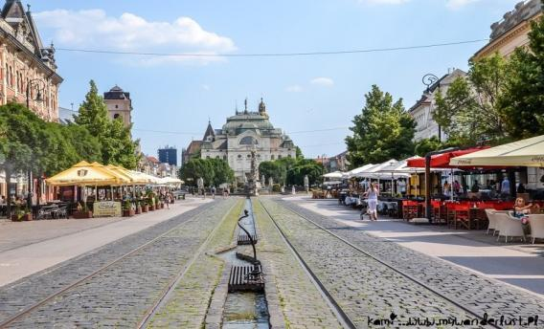
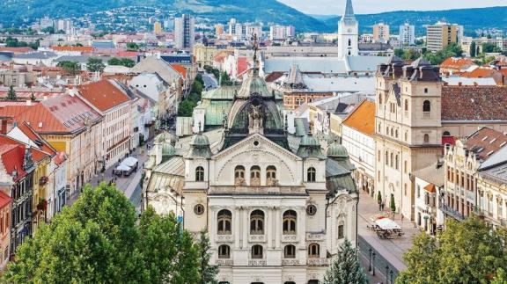
History
Košice has a rich history
In the centre of city there are sights of gothic, baroque and classic architecture
The centre creates the biggest sights reservation in Slovakia

Slide 12
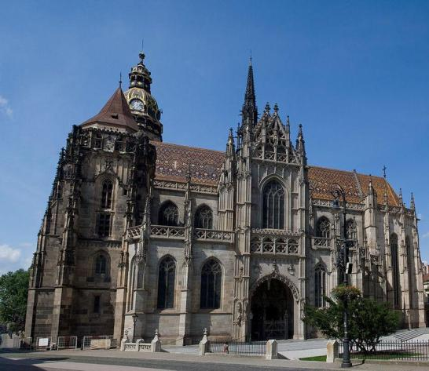
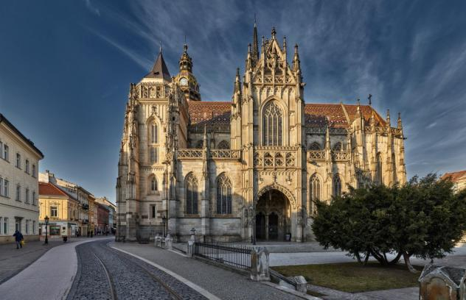
St. Elisabeth´s Cathedral
It´s the eastern most Gothic cathedral in Europe, the largest church in Slovakia, and of the pride of the city of Košice. Building has been in the city since the end of 14. century

Slide 13
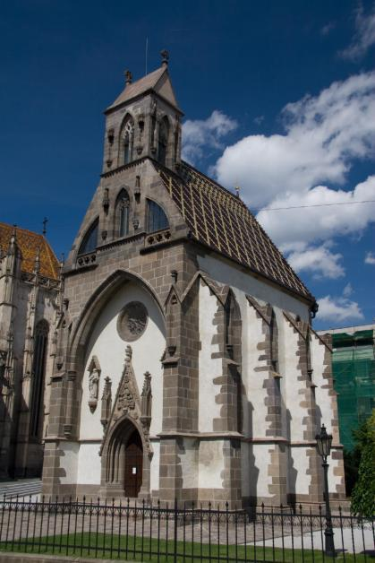
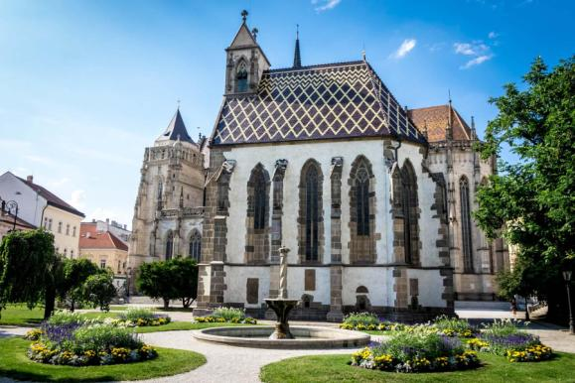
St. Michael Chapel
It is a Gothic style chapel and church in Košice

Slide 14
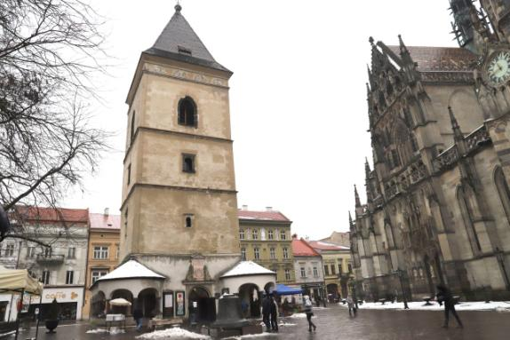
Urban´s Tower
It is the 45-metre high tower, originally designed as a bell tower of St. Elisabeth's Cathedral.

Slide 15
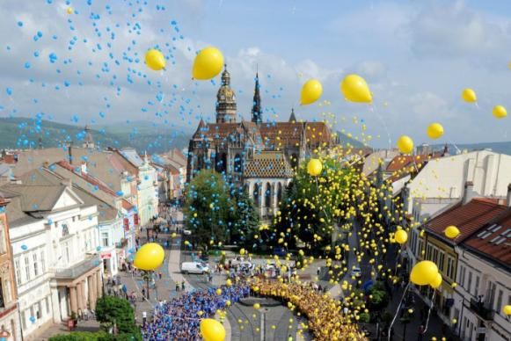
Events
Košice City Days – it´s a celebratings of the “birthday” of the Košice
Art Film Fest – international film festival

Slide 16
Summer Shakespeare Festival
Central European Theatre Festival

Slide 17
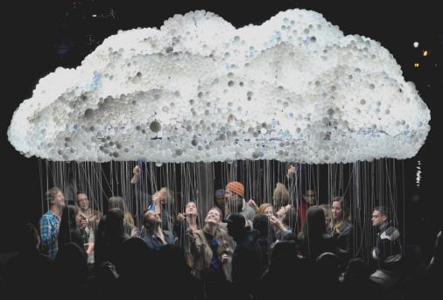
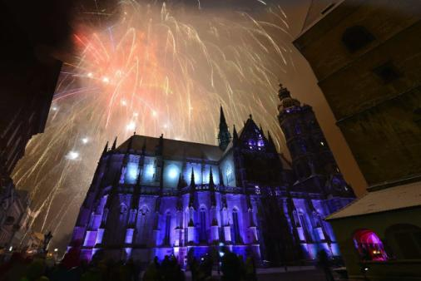
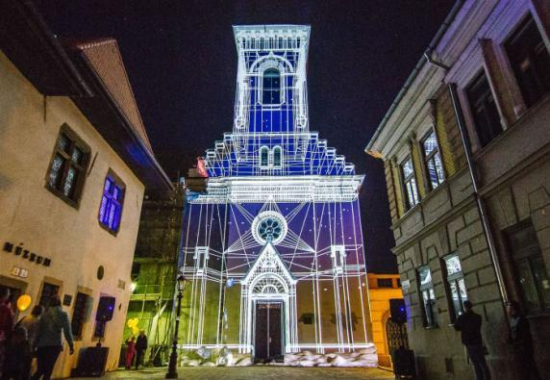
White Night – it´s the biggest international festival of contemporary art in Slovakia, that gives life to night by the artistic play of light and music.

Slide 18
Recreation
The most popular leisure activities being in the historic core of the city...

Slide 19
A Singing Fountain is located in the Central Square

Slide 20
Crafts Lane is a place with traditional crafts and original souvenirs

Slide 21
ZOO Košice is the largest zoo in Central Europe with 150 species of animals

Slide 22
Botanical Garden is fascinating university gardens with over 4 000 species of plants

Slide 23
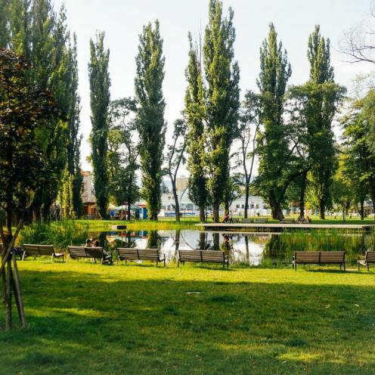
Parks
The City Park is the biggest park in Košice. It is dating since the 19. century and it´s located between railway station and center of city.

Slide 24
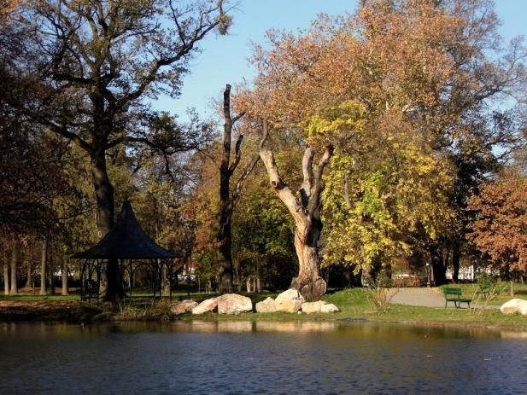
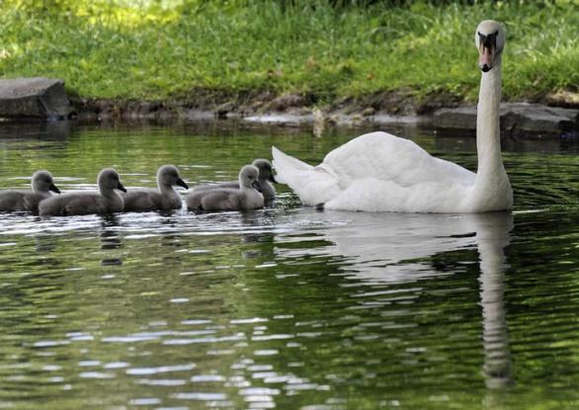
Park Barca is the second popular park in Košice. It´s a protected zone with important trees.

Slide 25
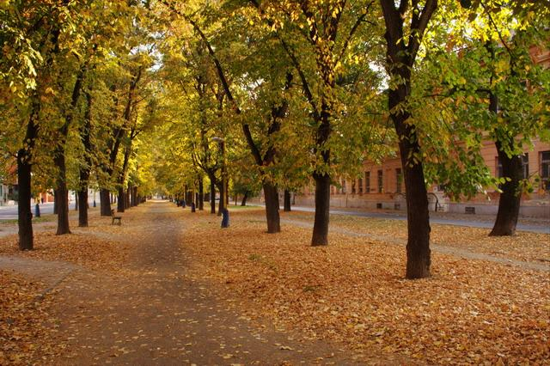
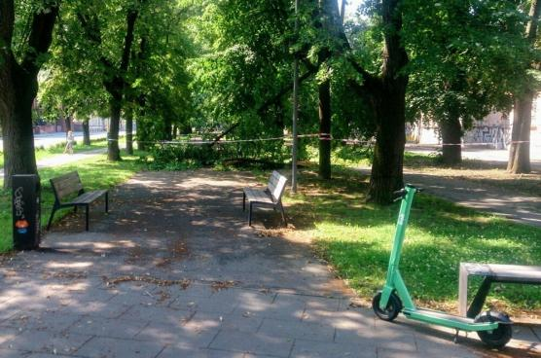
Park on Moyzesova street it´s a park-alley, there is science university and medical school around

Slide 26
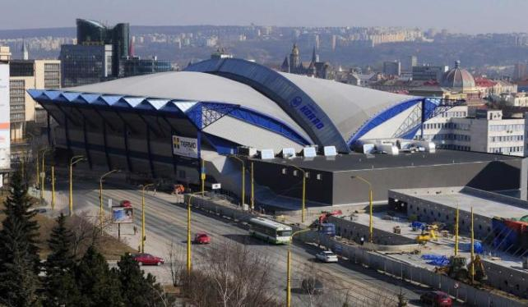
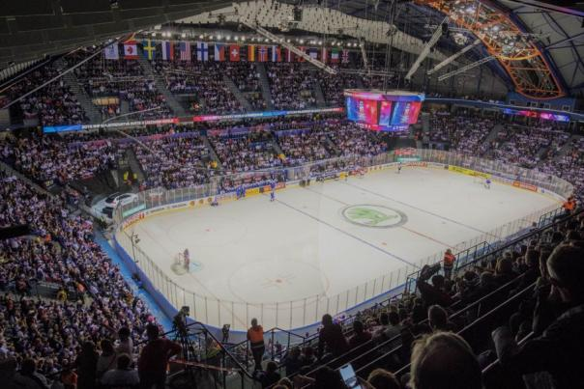
Steel Arena
There are organizing performances, concerts, but more important are hockey matches.
In 2019 there was the World Hockey Championship

Slide 27
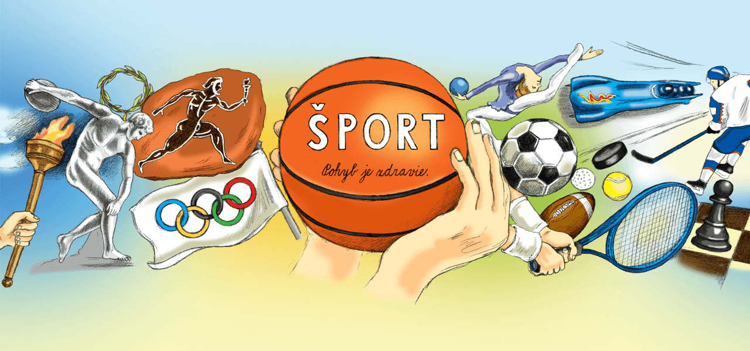
Places for sport...:

Slide 28
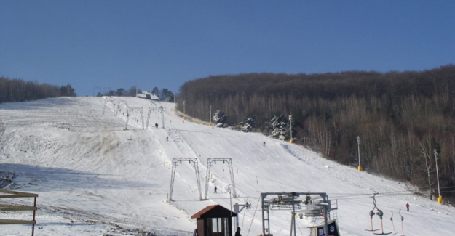
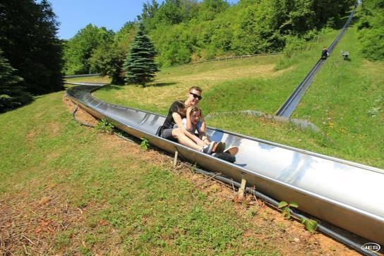
Kavečany
It´s a region, where there are ski station, summer tobbogan ride, cycle tracks and turistic paths.

Slide 29
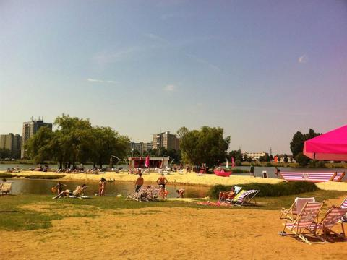
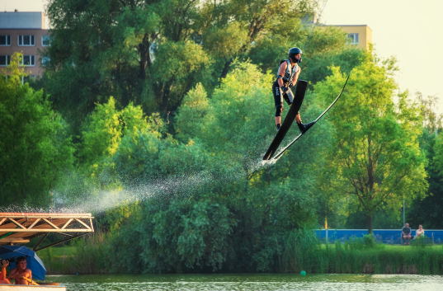
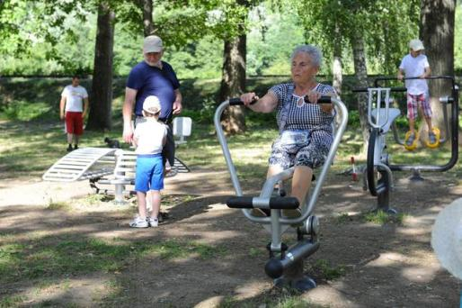
Nad jazerom
In this region, are located a water skiing centre, volleyball
and football ground and piece of coast is modify for sand beach.
There is also a workout area.

Slide 30
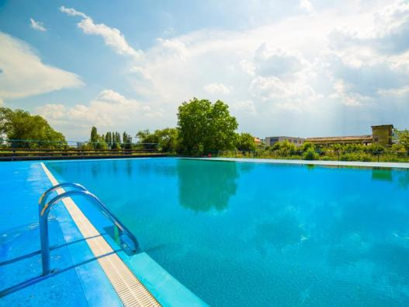
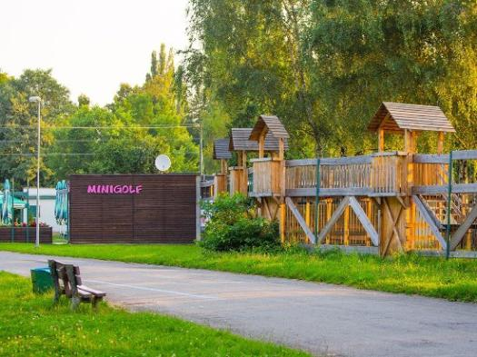
Anička Area
In this area, are many playgrounds for kids and a minigolf. There are also tenis ground, waterpark and a workout area.

Slide 31
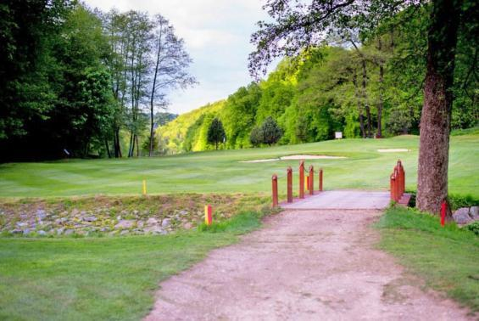
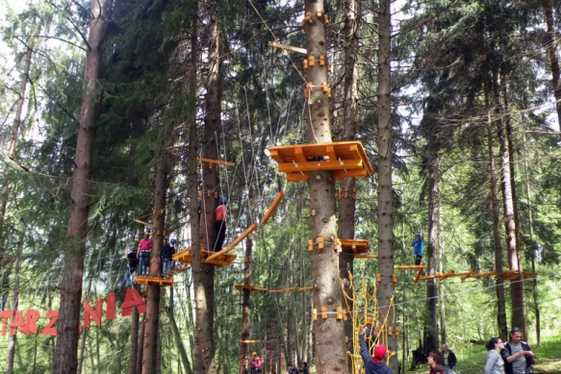
Alpinka Recreation Area
It´s a place for picnic and for family near Čermeľ brook and near the children´s railway track. It offers children playgrounds, high rope park Tarzania and a golf course.

Slide 32
Kosice is a beautiful city for living.

