Slide 1
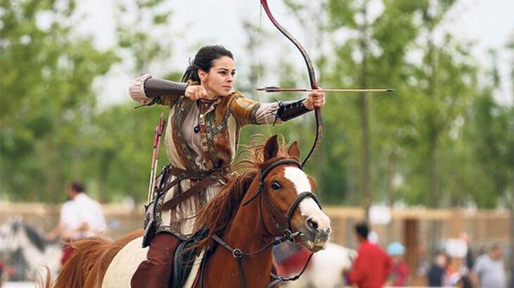
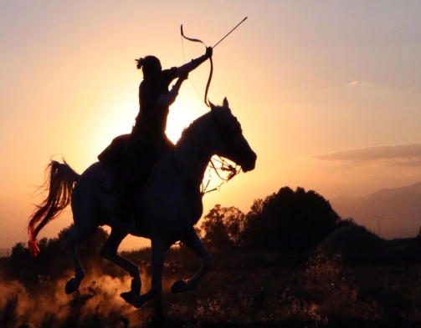
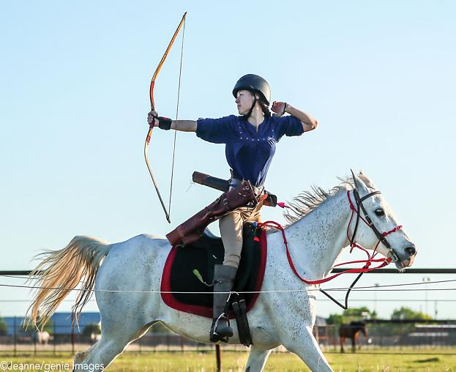
MOUNTED ARCHERY
MUSCLES
Archery works the whole body, especially back and arm muscles.
It provides strengthening of joints and tendons, shoulder, back and leg muscles.
It plays an important role in the treatment of spinal curvature.
It provides great support to the elimination of posture disorders.
PSYCHOLOGICAL
-They learn to cope with stress and solve stress and anxiety in daily life with the discipline provided by archery. Their motivation gets stronger and they can move forward by setting a goal for the future. It is also useful in treating distraction that is common in today's children. The child's concentration increases as focus is needed while shooting arrows. Thus, positive developments are seen in children with distraction.
ELİF CEYLAN 7-A

