Slide 1
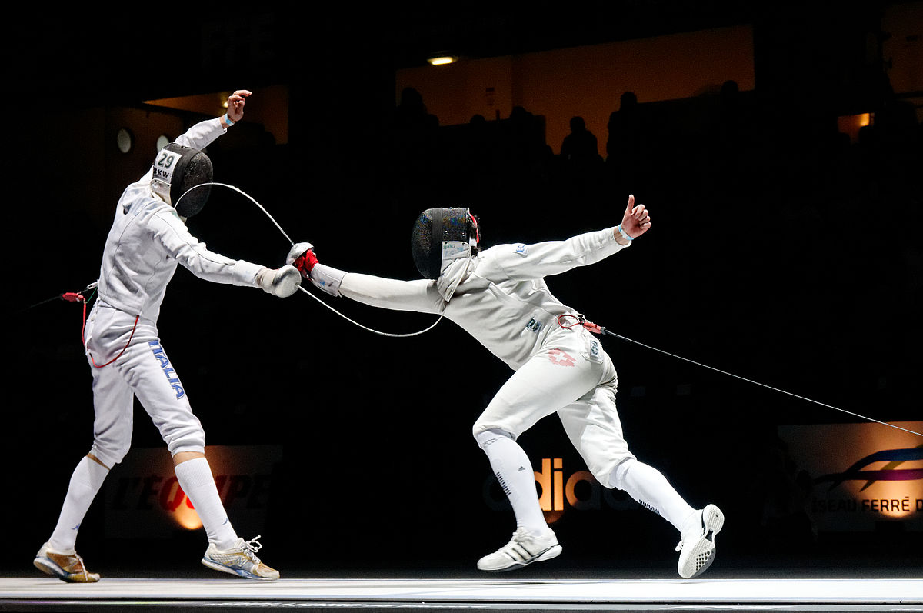
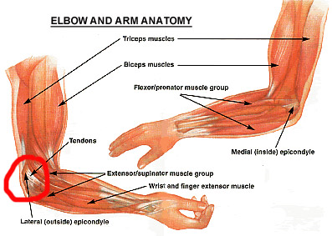
FENCING
Fencing is a combat sport that has gained popularity from its appearances in the Olympics and the exciting, fast-paced nature of each match. Each fencing session is a full-body workout and challenges muscles ranging from those in the feet and lower legs all the way up to the neck, shoulders and arms.

Slide 2
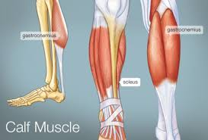
Whch muscles working in Fencing ?
Calves
Fencing involves constant footwork. To exhibit skill in the sport, it’s necessary to be able to move quickly, demonstrate lightness on your feet and be flexible with movements. Since the calves take the brunt of any sudden leg movements, an accomplished fencer’s lower legs are often extremely chiseled and defined. Strong calf muscles lead to quick, explosive movements, and improving in the sport requires strengthening those lower leg muscles.

Slide 3
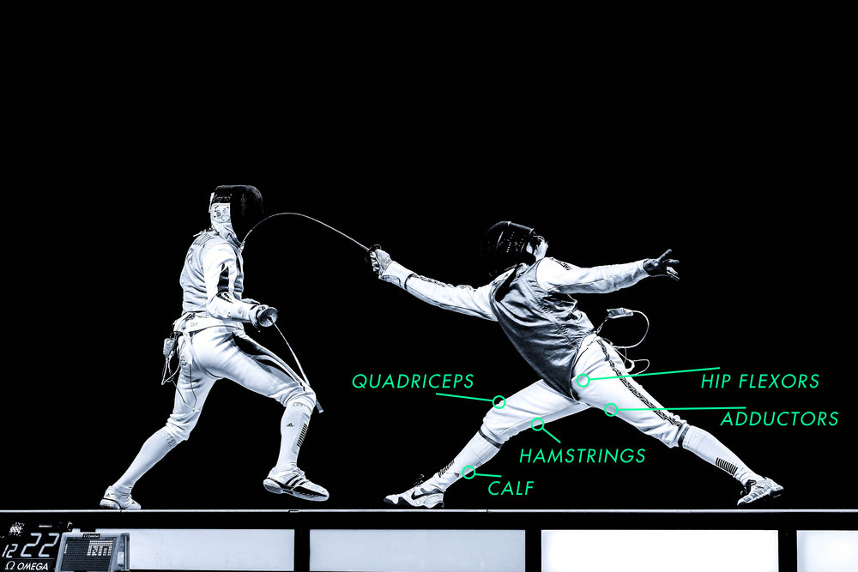
Core
The core and stomach muscles are largely responsible for balance, posture and stability, all of which are vital in fencing. A weak core means that a fencer won’t be able to keep his balance and will have trouble executing movements properly. In contrast, a fencer with a lot of experience has definition in the core, abdominal and midsection area from numerous balance and stabilization exercises as well as hours in combat.
?Knee To Elbow V2
>
DIFFICULTY
COMPLETE

Slide 4
Quadriceps
Every time a fencer lunges forward, backward or to the side, she works her thigh and quadriceps muscles. According to Fencing.net, even weight distribution in a lunge helps fencers stay upright and become more effective at their sport. In addition to lunges, fencers challenge their quad muscles whenever they dart in any direction or perform a split-step movement to center their weight and gravity.
Shoulders
According to Fitness-Facts.com, shoulders are one of the primary muscles that fencers use in combat and training. A fencer exercises and tones shoulders when darting forward to jab or pulling backward to avoid an attack. Common training exercises for fencers also include martial arts movements and shadow boxing, punching and sparring, which also work the shoulders and upper back.
Lower Back
Bouncing, an integral part of fencing, requires participants to brace the lower back to maintain balance and move effectively. In “Fencing: Steps to Success,” Elaine Cheris instructs fencers to stay on the balls of their feet when bouncing and to brace the lower back. Engaging lower back muscles and tightening them is an essential part of keeping your balance and successfully performing fencing maneuvers.

