Slide 1
Introductıon OF my School
Defne Telci 7-A

Slide 2
Purpose
To introduce my school for Erasmus Project.

Slide 3
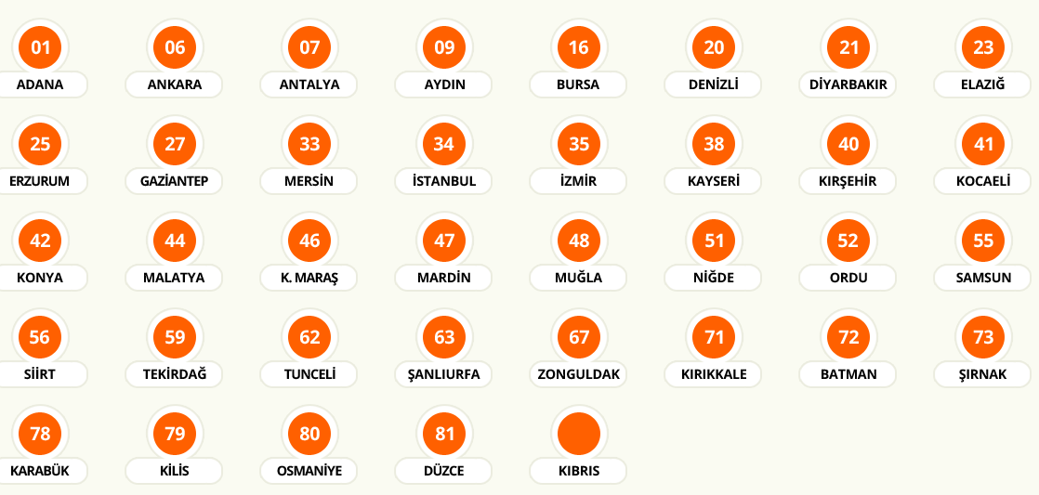
General Overview
My school is Final Okulları which is private college.
Final Okulları is a national school chain where is located at many different cities in Turkey.
It has full range of school: kindergarten, elementary, secondary, high school.
As well it has its own university.
Website:
http://www.finalokullari.com.tr/
Cities Where Campuses are Located

Slide 4
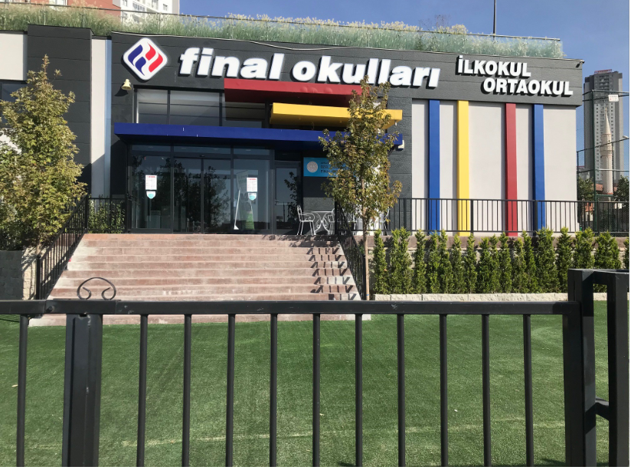
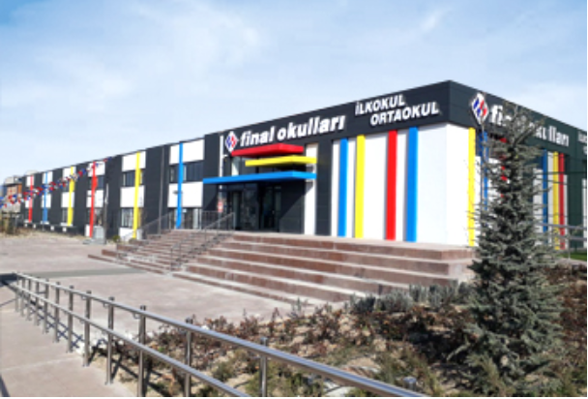
General Overview
I am living in Ankara.
There are 9 campuses in Ankara.
I am studying in Ankara Park campus.
In my campus, there are elementary and secondary school branches.

Slide 5
General Overview
Classes In My School
Other Classes and Activies Room
Canteen
Library
Computer Class
Music Room
Art Room
Football Court
Schoolyard
Basketball Court
Playgarden
Rest Room
Class No | Number of Class
1 | 2
2 | 2
3 | 2
4 | 2
5 | 1
6 | 1
7 | 1
8 | 1

Slide 6
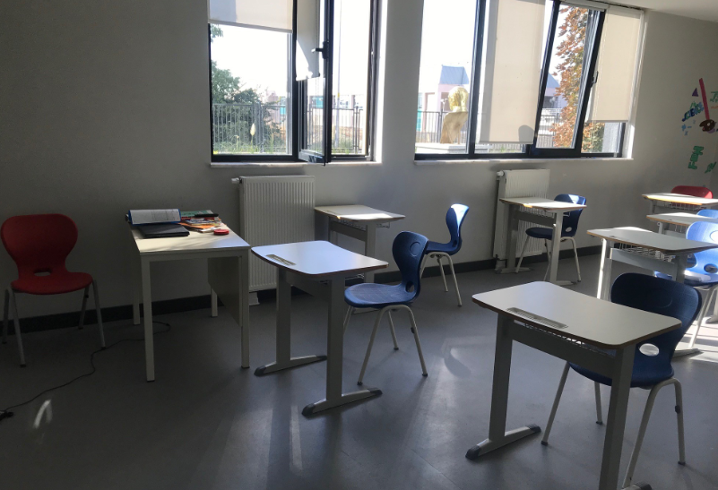
My Class

Slide 7
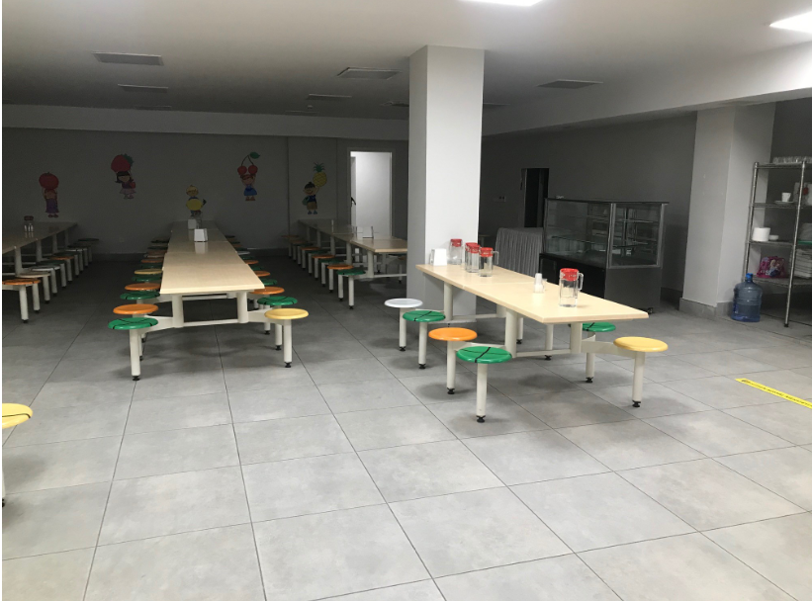
Canteen

Slide 8
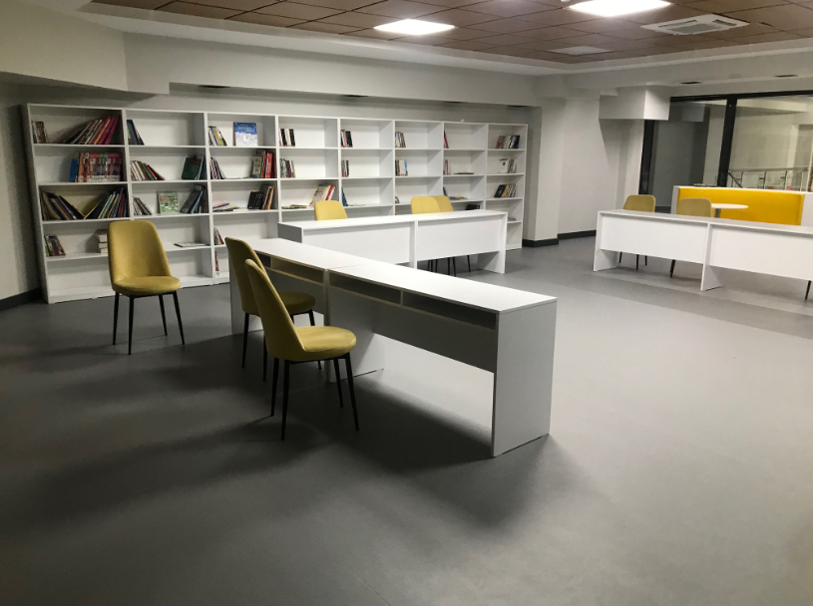
Library

Slide 9
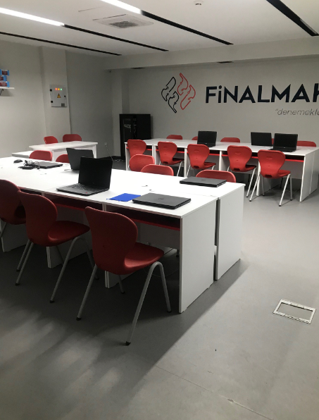
Computer Room

Slide 10
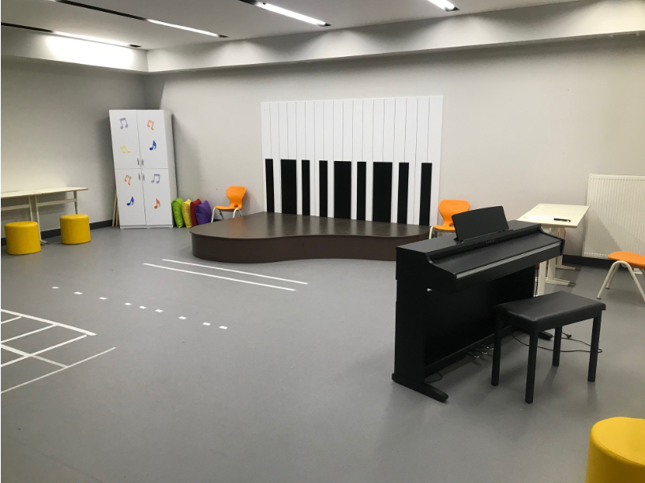
Music Room

Slide 11
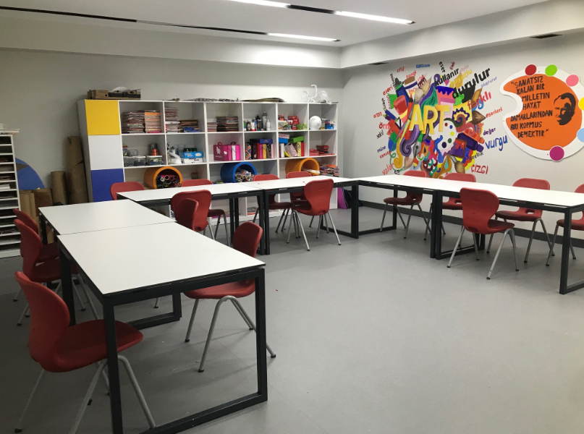
Art Room

Slide 12
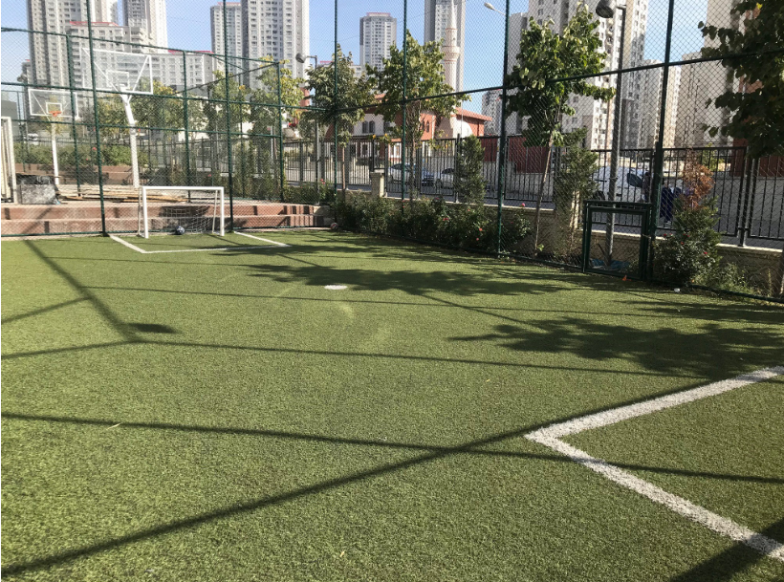
Football Court

Slide 13
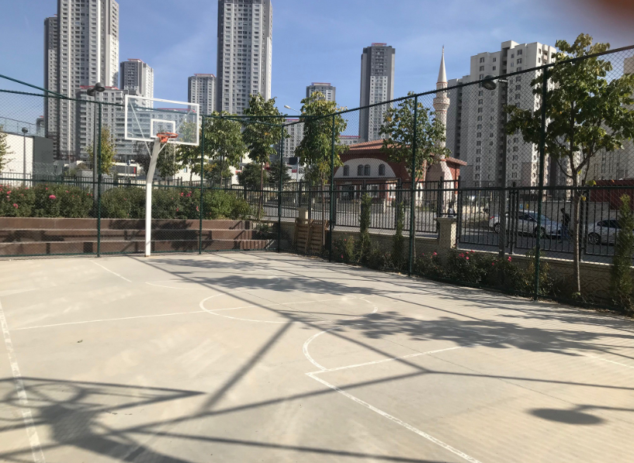
Schoolyard

Slide 14
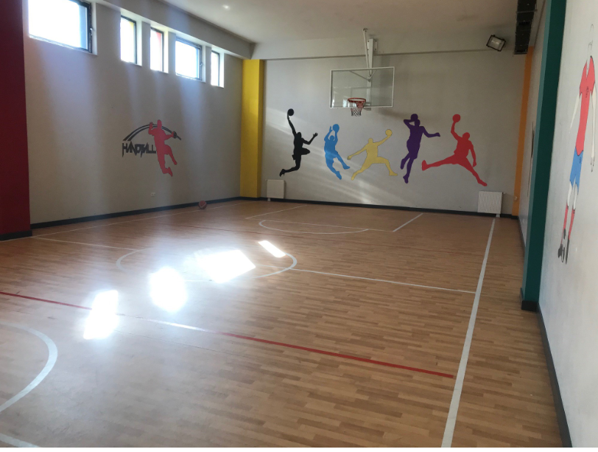
Basketball Court

Slide 15
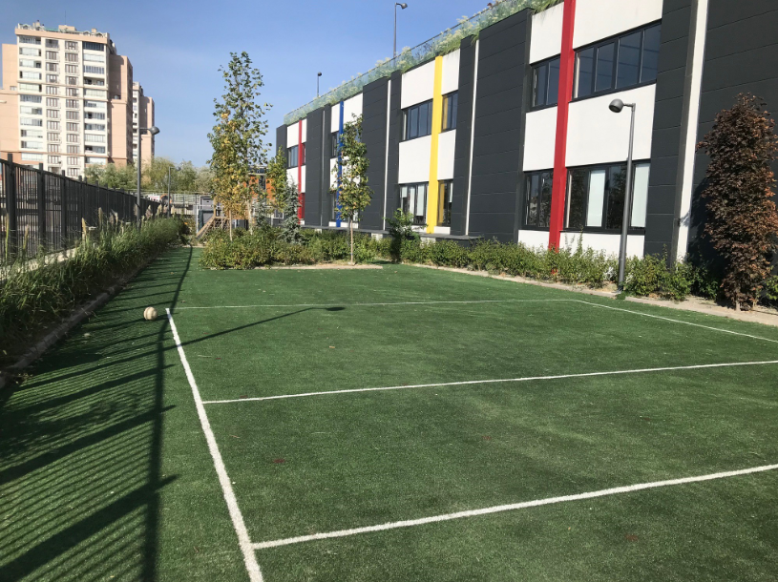
Playgarden

Slide 16
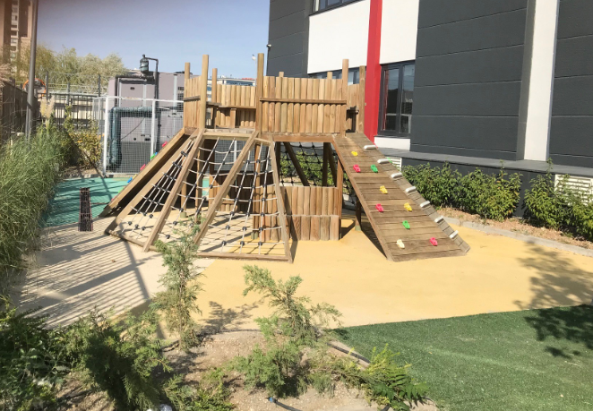
Playgarden

Slide 17
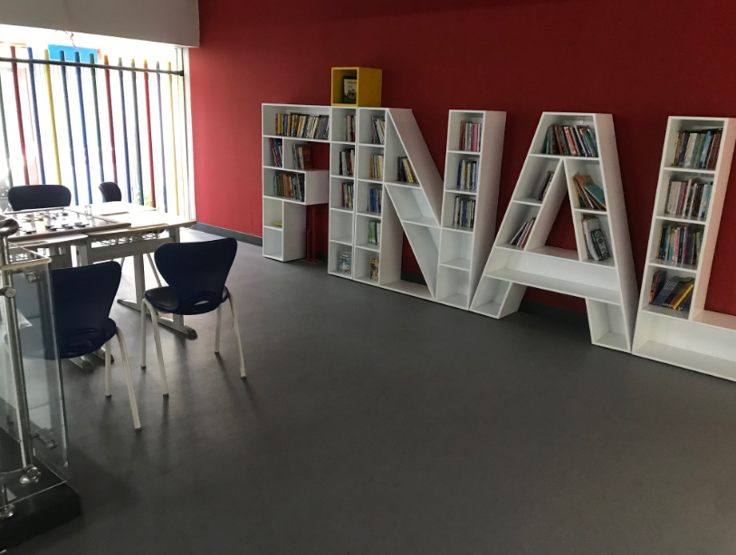
Rest Room

Slide 18
Questions?
Thank You

