Slide 1
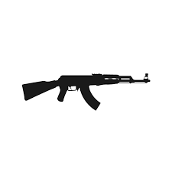
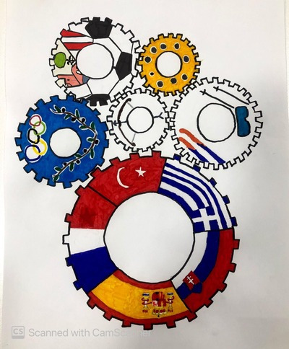
Zuzana rehák štefečeková

Slide 2
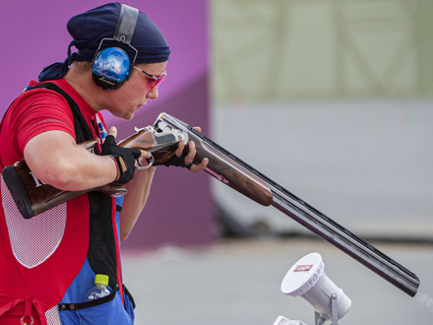
Zuzana rehák štefečeková
Her coach is Branislav Slamka
club - ŠKP Trnava
name of the center - Police Sports Center
She has been involved in sport shooting since 1996
Motto: Be happy with yourself.

Slide 3
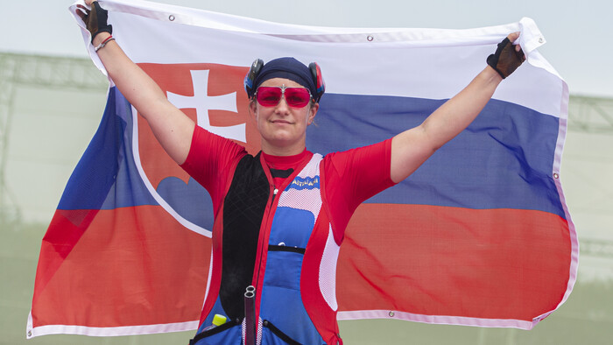
awards
2003 - awarded the Ondrej Nepel Prize by the Slovak Olympic Committee to athletes under the age of 23 with a strong sporting perspective
2011 – named as the most successful athlete by the Ministry of the Interior of the Slovak Republic in 2010
2018 - she is a holder of the Crystal Wing award in the sports category

Slide 4
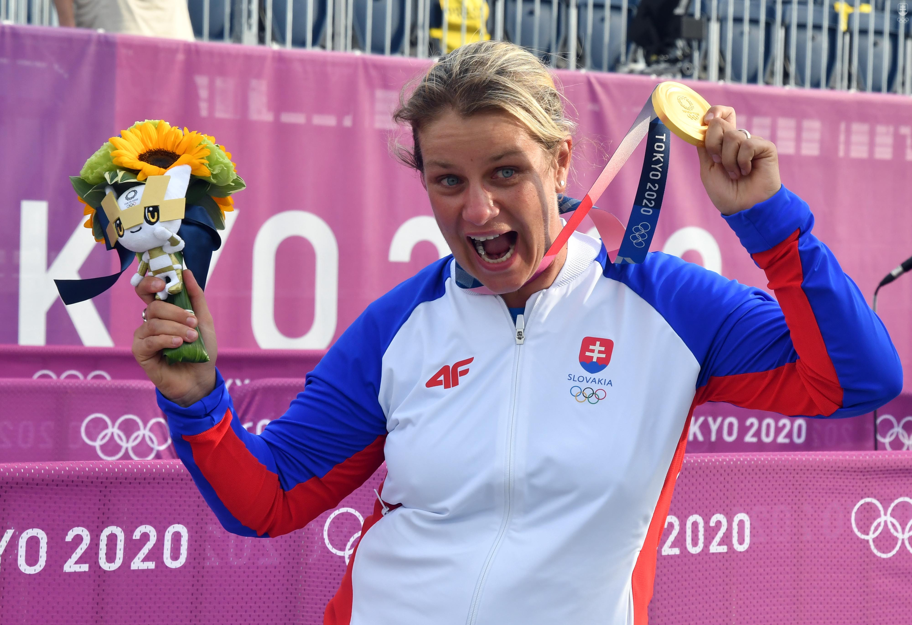
Greatest achievements
2008 - at the Summer Olympics she won a silver medal in trap shooting, when after qualifying she still led
2010 - she was the first Slovak to win the title of world champion in shooting
2012 - at the Summer Olympics she won a silver medal in shooting - the trap discipline
2015 - at the European Games she won gold in the trap and in the mix
2020 - at the Summer Olympics in Tokyo, she first dominated the qualification of the trap, when she set a new world record with 125 out of 125, then she also won the finals with 43 out of 50 and became the Olympic winner

Slide 5
sources
https://www.olympic.sk/sportovec/zuzana-rehak-stefecekova
https://sk.wikipedia.org/wiki/Zuzana_Reh%C3%A1k-%C5%A0tefe%C4%8Dekov%C3%A1#%C3%9Aspechy
https://www.olympic.sk/sportrevolution/spiker/zuzana-rehak-stefecekova

Slide 6
information
Presentation by: Zoja Tomadlíková
School: Stredná zdravotnícka škola Moyzesova 17, Košice
E-mail adress: ztomadlikova0@gmail.com

