Slide 1
CIRIT A TRADITIONAL SPORT
Yavuz Selim YILDIRIM

Slide 2
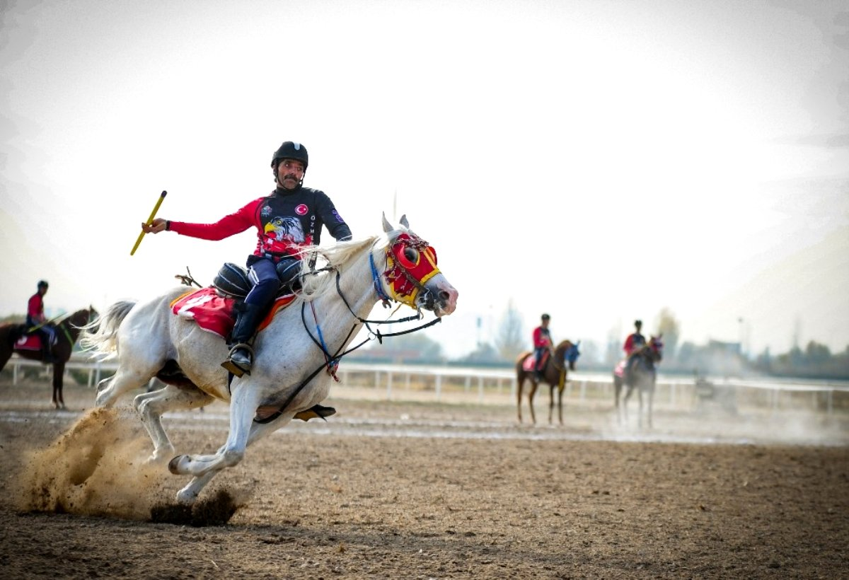
Javelin is one of the sports that is played on horseback. It is a sport with rules that aims the athlete on a horse to throw his javelin accurately against the opponent, to dominate himself and his mount during the battle, and to overcome his opponent in this way.

Slide 3
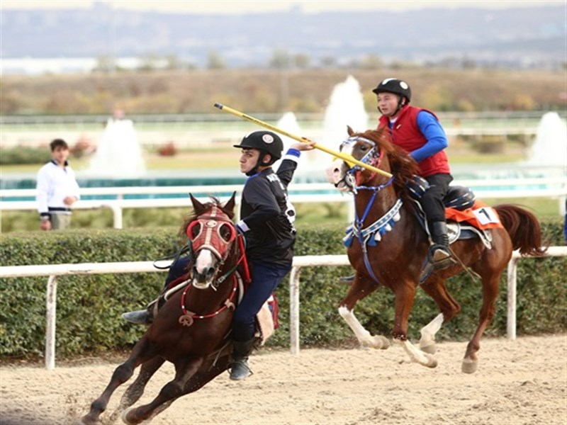
It is one of the games that we do not see much today, which the Turks call ancestor sport from ancient times. It is known that it is still played in Erzurum, Bayburt, Kars, Balıkesir and Konya provinces.

Slide 4
History. Javelin is known as the war game that Turks have played since their arrival from Central Asia to Anatolia. ... 11-16 in Anatolia. Played as a war game in the centuries, javelin was the biggest show sport in the Ottoman Empire country and palace in the 19th century.

Slide 5
I am a Turkish student and a sport lover. I tried to explain and Show you what CIRIT is. Thank you
Yavuz Selim Yıldırım

