Slide 1
Rhodes

Slide 2
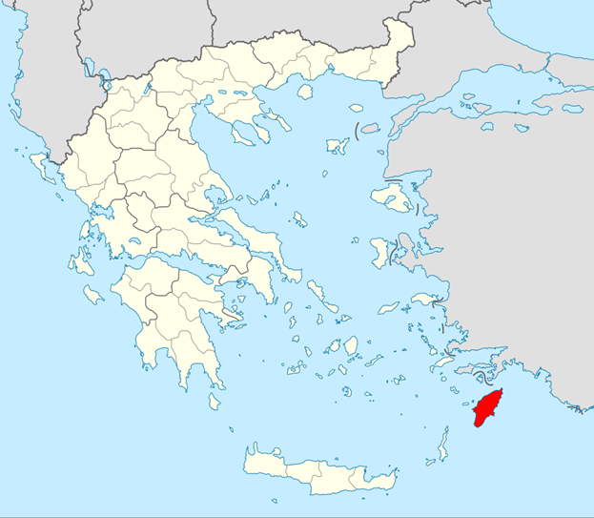
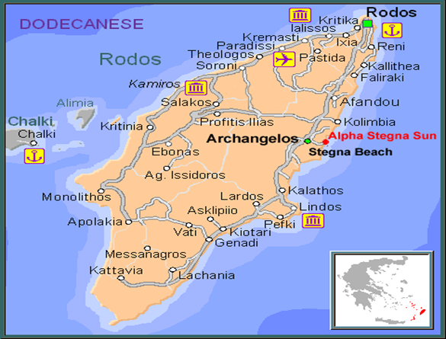
Rhodes island
The island of Rhodes is at the meeting point of three continents and it has known many civilizations who left their mark in all aspects of the island's culture: art, language, architecture.

Slide 3
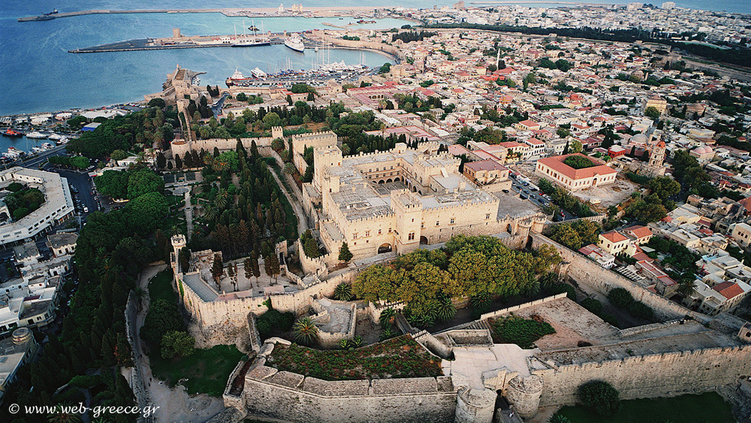
Rhodes is the largest island in the Dodecanese and the fourth largest in Greece. Its capital city, located at its northern tip, is the capital of the Prefecture with the Medieval Town in its centre.

Slide 4
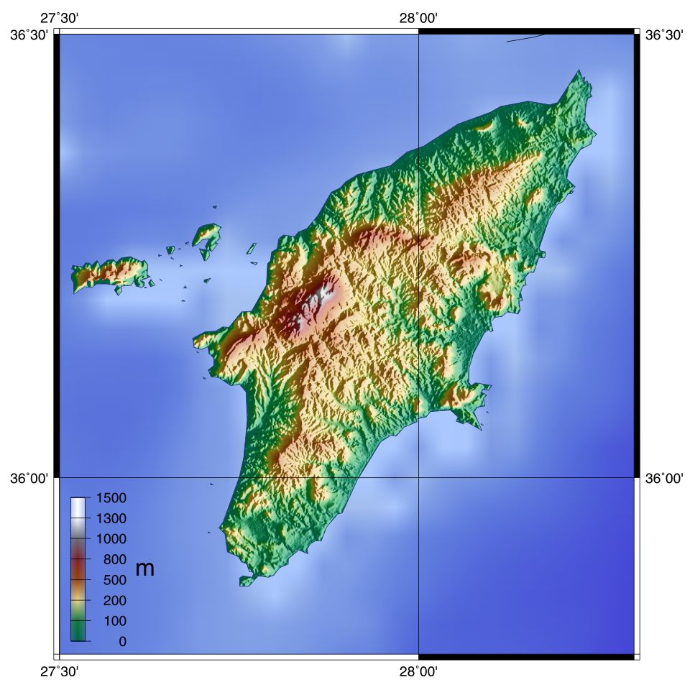
The island of Rhodes is mountainous. The main mountain is Atavyros.
Rhodes has a mediterranean climate, mild winters, and hot summers. It has 300 days of sunshine a year and high humidity.
The island's main products are olive oil, wine, vegetables and citrus fruit.

Slide 5
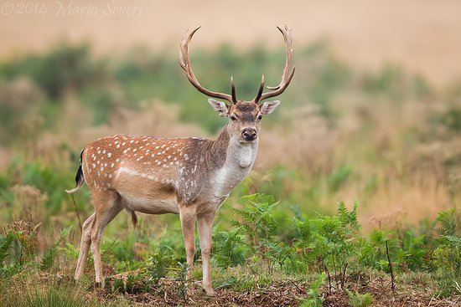
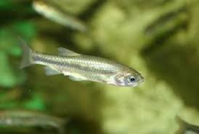
Typical flora: conifers, oaks, thyme, capers, and many wild flowers.
Typical fauna: platoni (Dama dama), ghizani fish, Caretta caretta, peacocks.

Slide 6
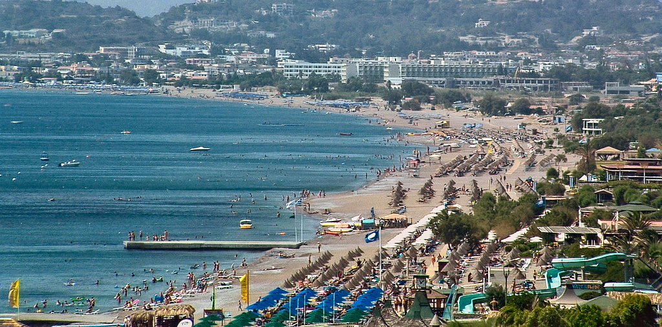
Economy
based on tourism (1.000.000 visitors a year).
The population, which up to the 1950's was very largely engaged in farming and stockbreeding, then realized that tourism could be more profitable.

Slide 7
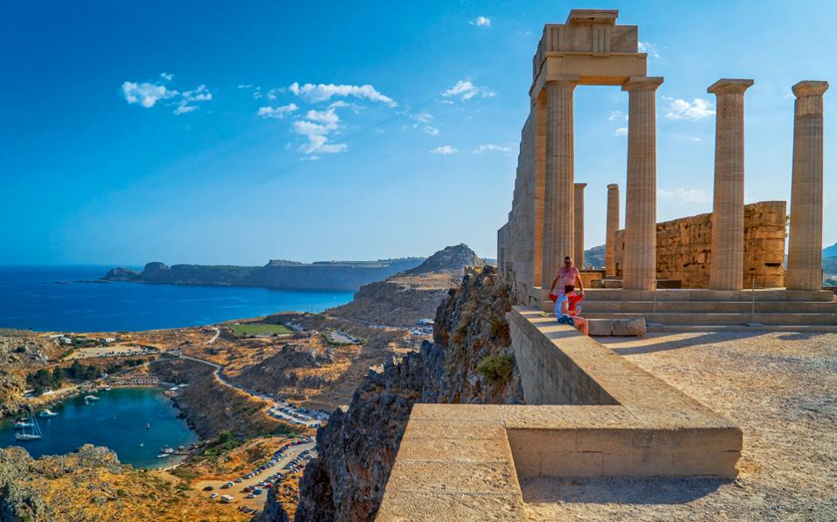
HISTORY OF RHODES
Archaeological excavations revealed that in the 16th century BC the Minoans inhabited the island, followed by the Mycenaeans, who settled here in the 15th century BC.
In about 900 BC there were three cities on the island, Ialysos, Lindos and Kamiros.
Acropolis of Lindos

Slide 8
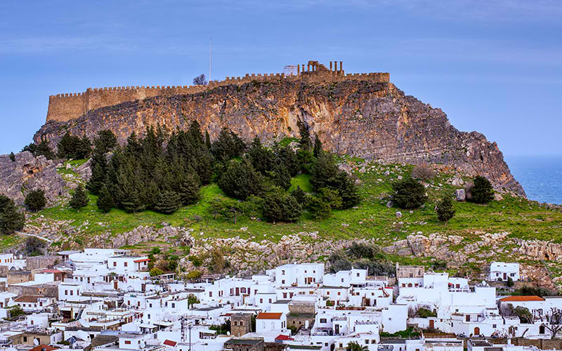
Lindos

Slide 9
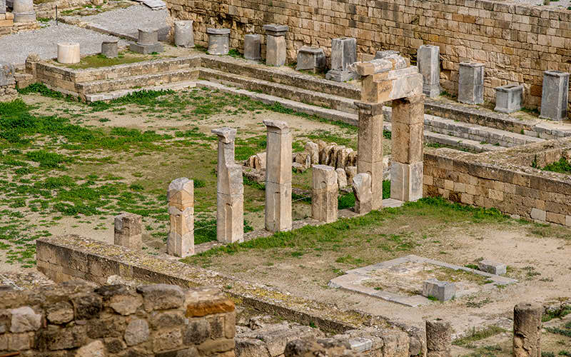
Ancient town of Kamiros

Slide 10
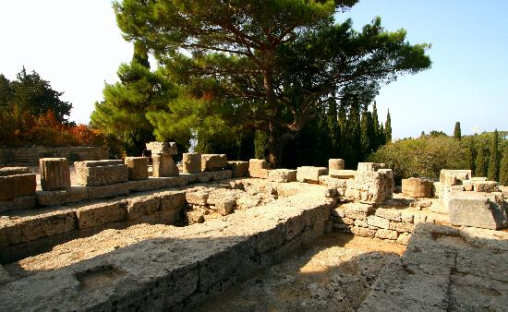
Acropolis of Ialysos

Slide 11
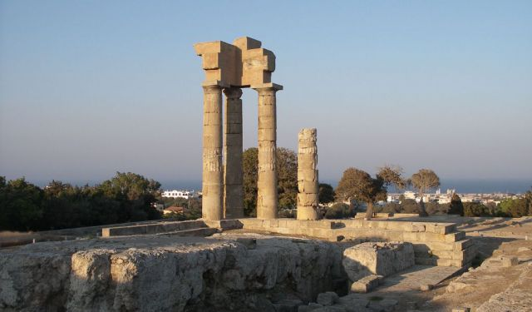
A milestone in the history of the island was the decision of the three cities in 408 B.C. to jointly found a new powerful city at the northern tip.
Rhodes Acropolis

Slide 12
Colossus of Rhodes
After the successfully repelling the siege led by Demetrius the Conqueror (302 BC), the Rhodians commissioned the construction of the Colossus, one of the seven wonders of the ancient world, to sculptor Harris.
The Colossus of Rhodes is usually shown in this way.
For structural reasons, however, it is very unlikely that a statue 31-32 metres high, with its feet astride the entrance of the harbour could have remained standing without further support.
The Colossus of Rhodes eventually collapsed in an earthquake.

Slide 13
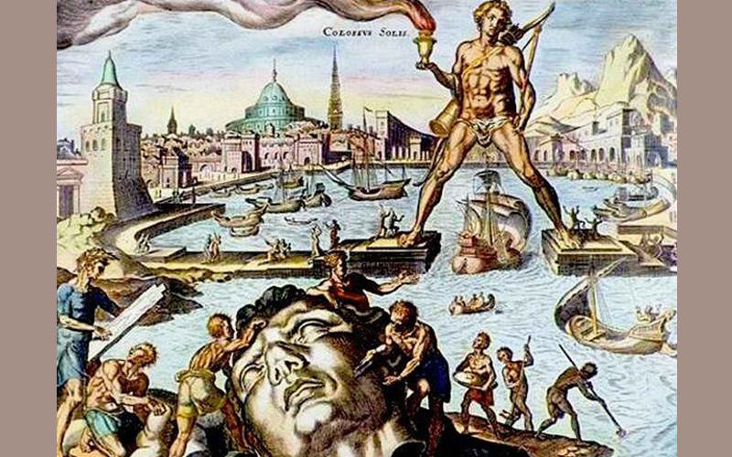
Parts of Colossus lie on the ground after the earthquake, engraving

Slide 14
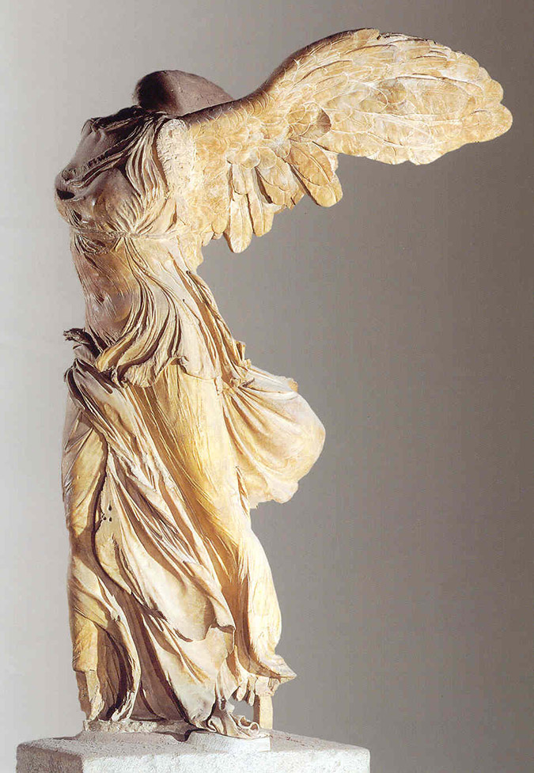
By 42 BC Rhodes had entered a period of decline, and it was easily captured by the Romans, who carried off many of its statues and other art treasures.
The Winged Victory of Samothrace (today in the Louvre Museum, Paris), was the creation of three Rhodian sculptors: Agesandros, Polydoros and Athenodoros

Slide 15
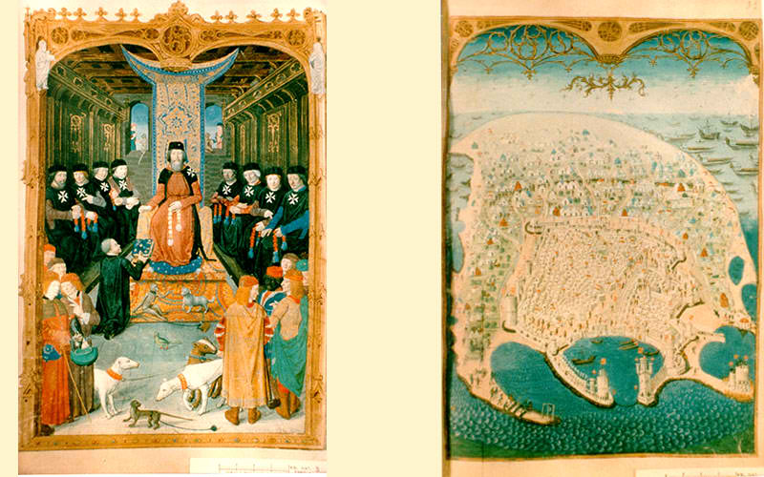
KNIGHTS
In 1309 AD, Rhodes fell into the hands of the Knights of the Order of St. John of Jerusalem. The “renaissance“ of Rhodes in every sector, from trade to arts and letters, lasted about 200 years. The early Byzantine "Castle" was named “Collachio” (Collachium) and included the Palace of the Grand Magister, St. Johnn's church, the “Inns of the Tongues” of the Knights, the Hospital and the Arsenal.

Slide 16
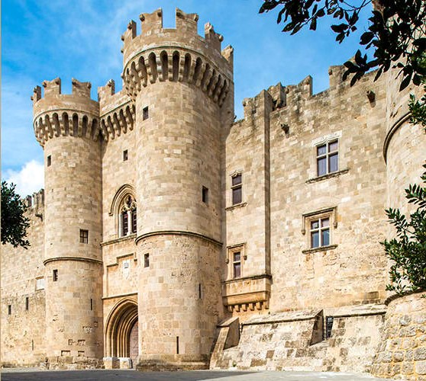
The entrance to the palace of the Grand Master

Slide 17
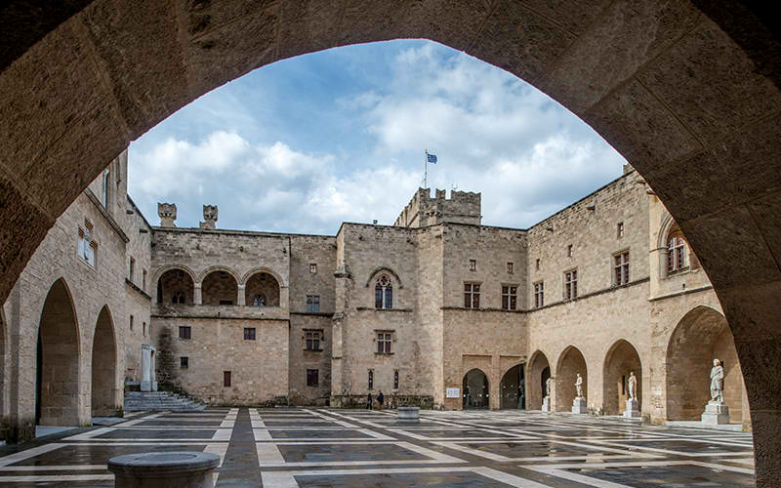
The atrium of the Palace of the Grand Master

Slide 18
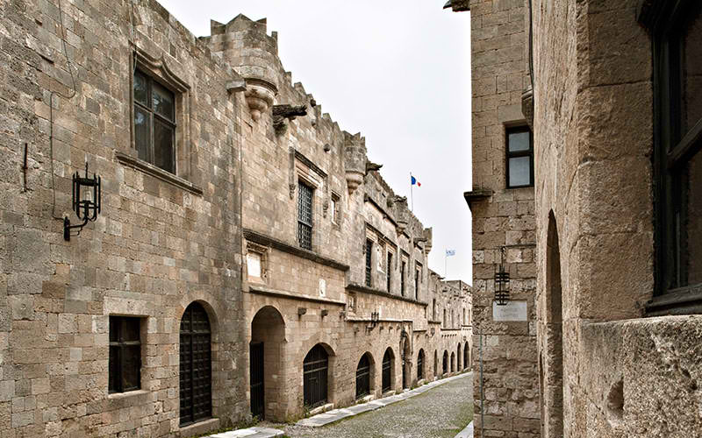
The street of the knights

Slide 19
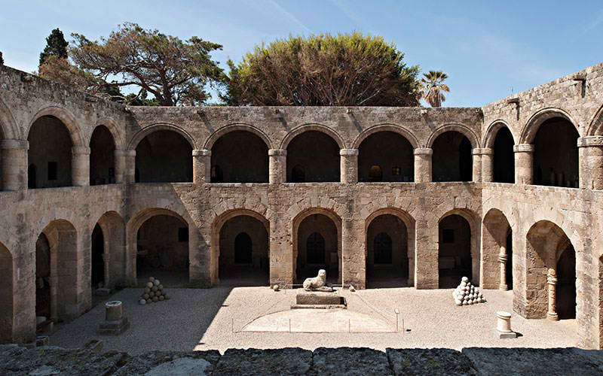
The hospital of the knights, today the archaeological museum of Rhodes

Slide 20
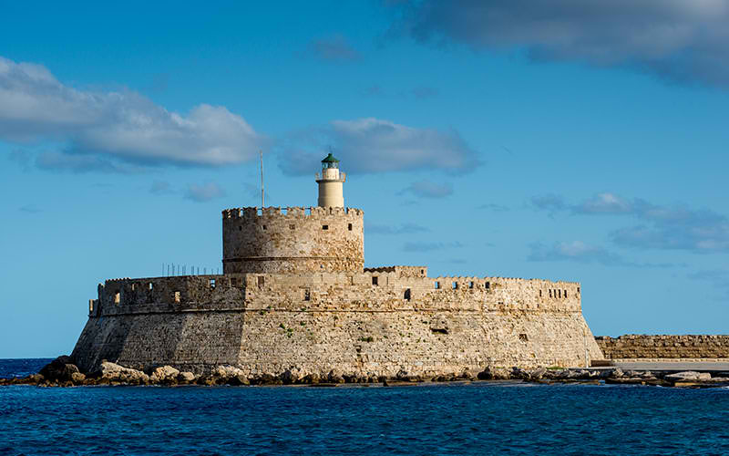
St Nicholas castle and lighthouse

Slide 21
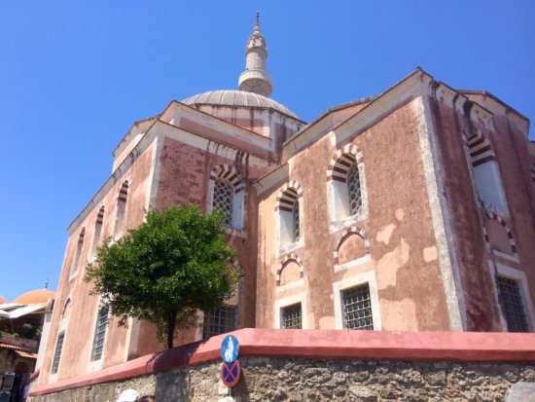
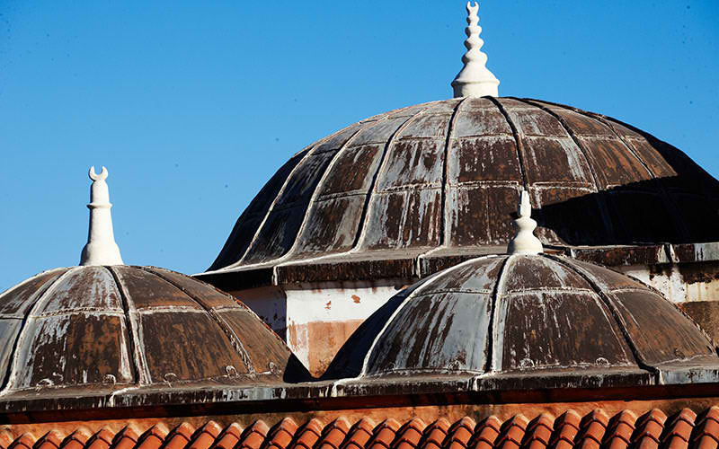
OTTOMANS
The Ottomans conquered the island in 1522. Rhodes became a provincial town of the Ottoman Empire for almost four centuries.

Slide 22
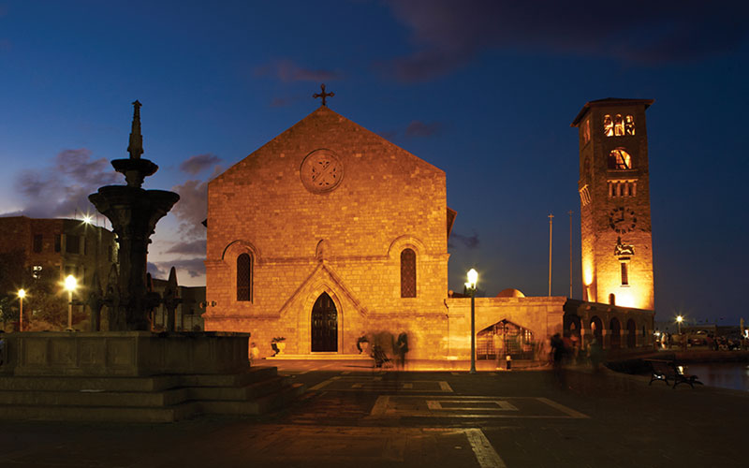
ITALIANS
In 1912 Italy occupied Rhodes. Through the occupation excavations took place revealing important ancient monuments. At the same time, extensive restorations of the medieval monuments were organized, including the reconstruction of the Palace of the Grand Magister and the construction of St. John's church in Mandraki, in the modern city, as a copy of St. John's church of the Knights which was destroyed in 1856 by an explosion.

Slide 23
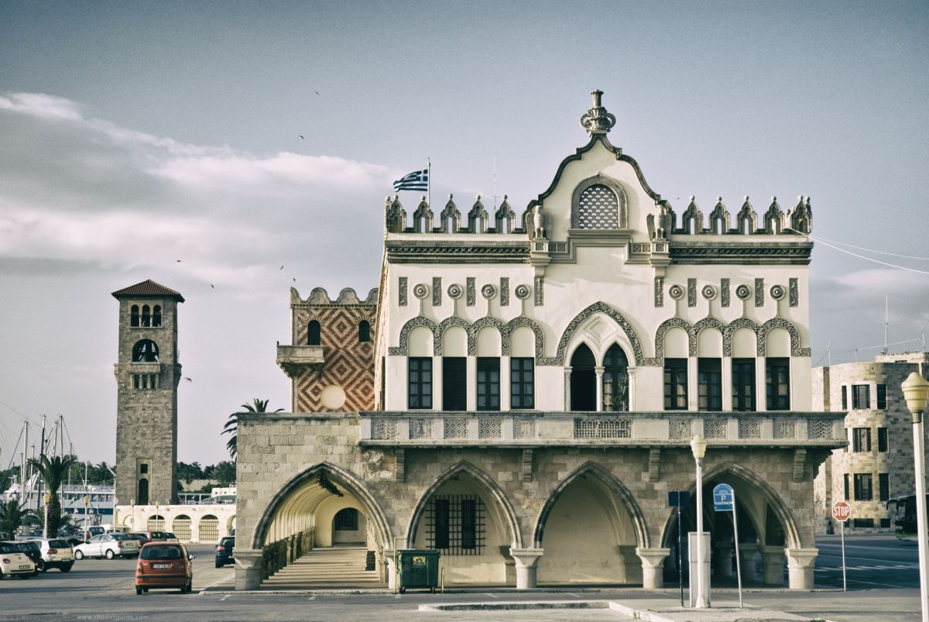
The former Governor's Palace, now used as the the Building of the Prefecture, It is one of the most considerable buildings constructed on Rhodes during the Italian occupation of the island.

Slide 24
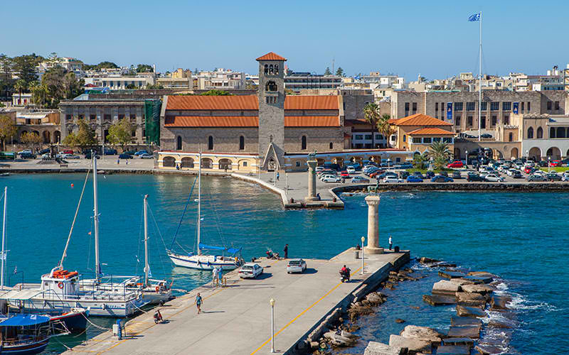
Mandraki port, new city of Rhodes

Slide 25
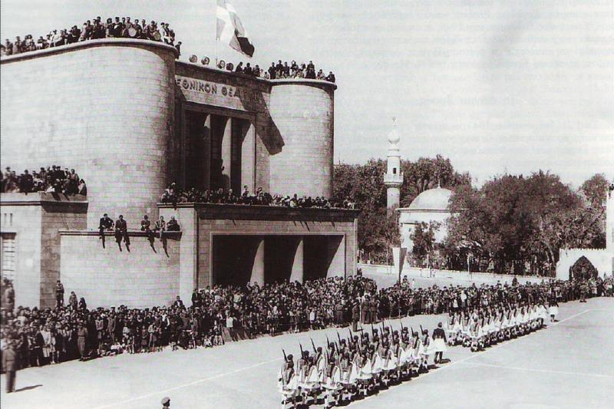
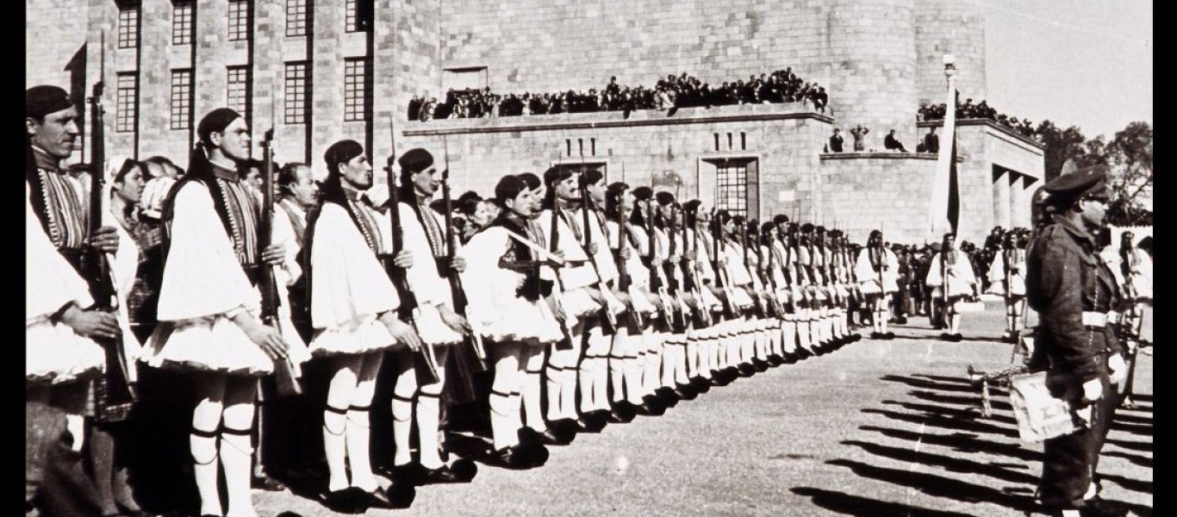
In 1948, Rhodes and the rest of the Dodecanese islands were formally incorporated in Greece.
Celebrations for the union of the Dodecanese with Greece in 1948

Slide 26
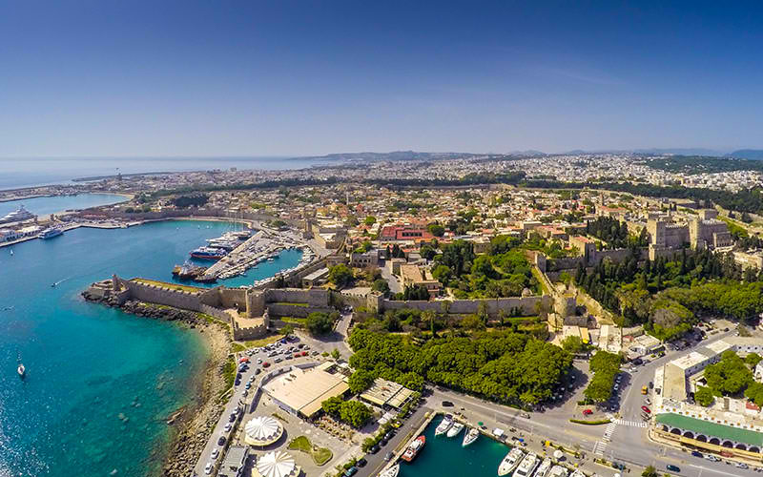
Gradually, Rhodes became one of the most popular tourist destinations worldwide.

Slide 27
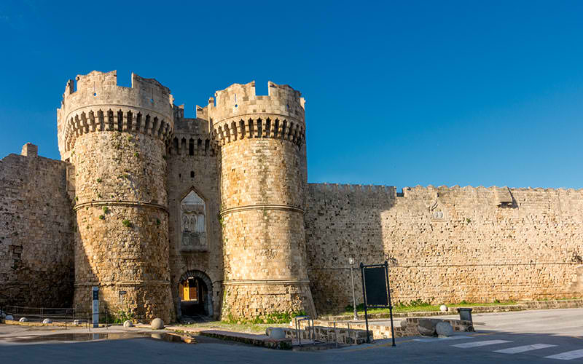
In 1988 the Medieval Town was declared World Heritage Site by UNESCO.
The marine Gate –medieval city of Rhodes

Slide 28
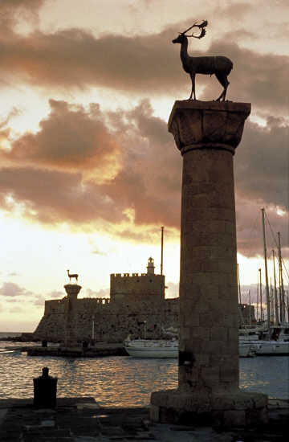
Rhodes
a crossroad
of civilizations

