Slide 1
Our survey was based on research made in 3 classes of the 10th Grade of the 4th General High School of Rhodes.
A total of 69 students participated in this survey in which 41 were girls and 28 were boys.

Slide 2
CONCLUSION:
From a total of 41 girls, 23 of them practice sports on a regular basis.

Slide 3
CONCLUSION:
From a total of 28 boys, 22 of them practice sports on a regular basis.

Slide 5
CONCLUSION:
The most popular sports among female students are the gym, dancing, football and volleyball.

Slide 7
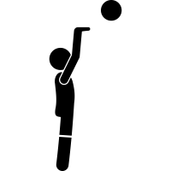
CONCLUSION:
The most popular sports among male students are football, the gym and basketball.

Slide 8
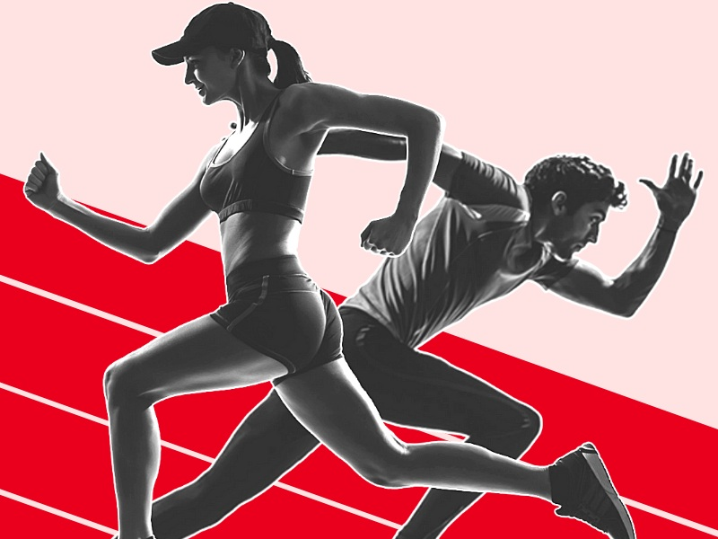
Is there any difference? If so, why do you think there is?
There is a huge difference in the research that has followed this question reason being the diversion in comparison between male and female classmates.
Men are more socially obliged to like and devote more time in sports than girls.

Slide 9
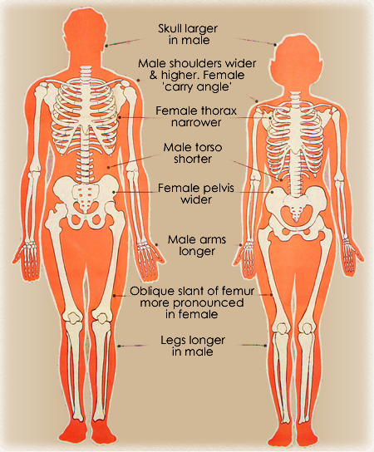
Male athletes have longer and larger bones than female athletes. That is a vital benefit because it can provide a clear mechanical advantage which is an additive to the increased articular surface and larger structure.
They're more stereotypically men grounded sports in comparison to female grounded ones, meaning that male athletes have more options.

Slide 10
Compare the situation in your class with official statistics in your country.

Slide 11
Do you think female sport practice should be encouraged?
There are several benefits involving female sport practice and it should be encouraged in every way possible.
Some of these benefits are the following:

Slide 12
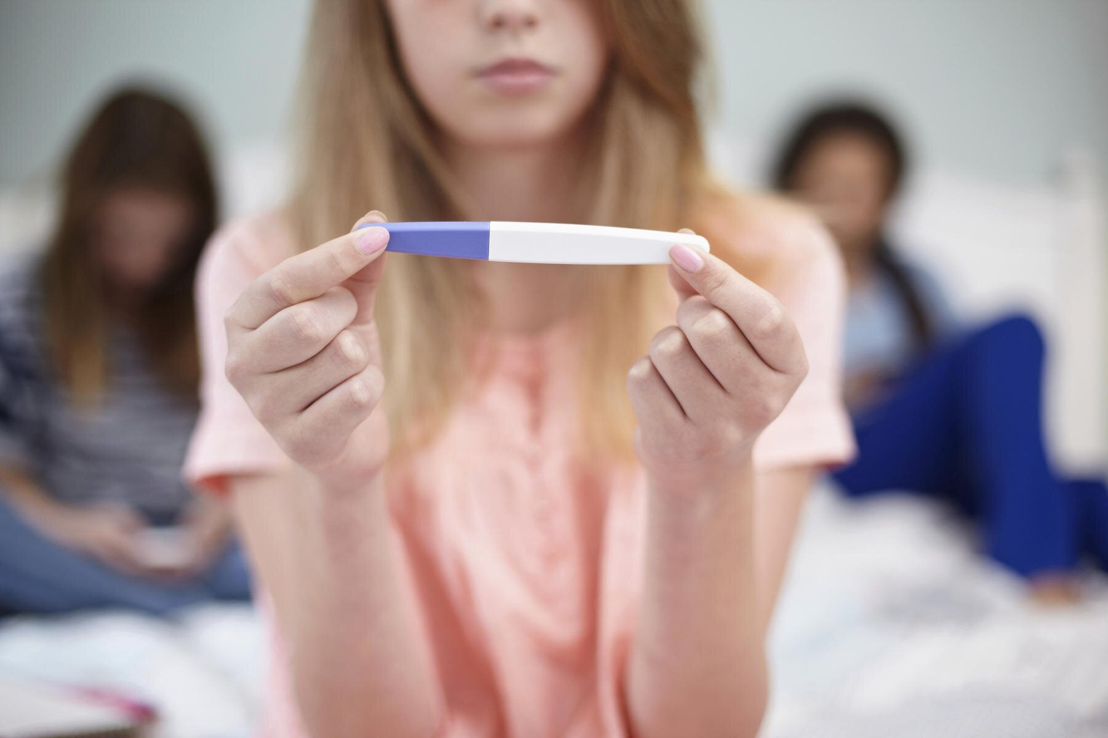
High school girls who play sports are:
less likely to be involved in an unintended pregnancy
more likely to get better grades in school and
more likely to graduate than girls who do not play sports.

Slide 13
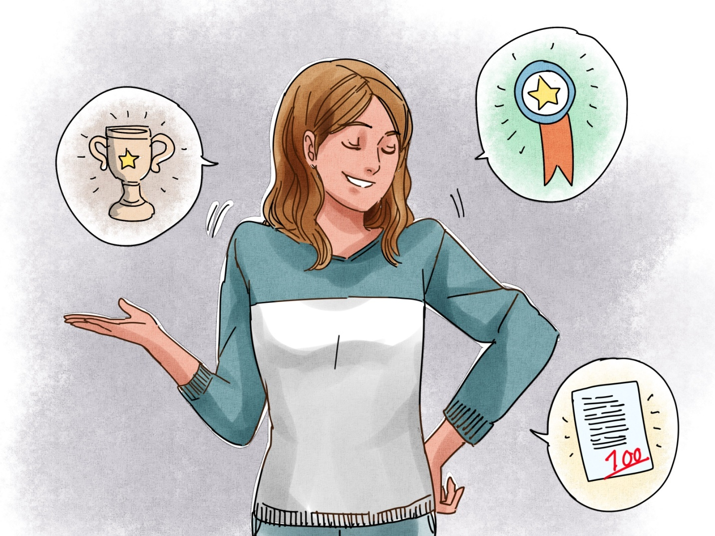
Girls and women who play sports have higher levels of confidence and self-esteem and lower levels of depression.

Slide 14
Girls and women who play sports have a more positive body image and experience higher states of psychological well-being than girls and women who do not play sports.

Slide 15
Sport is where you traditionally learn about teamwork, goal-setting, the pursuit of excellence in performance and other achievement-oriented behaviors—critical skills necessary for success in the workplace.

Slide 16
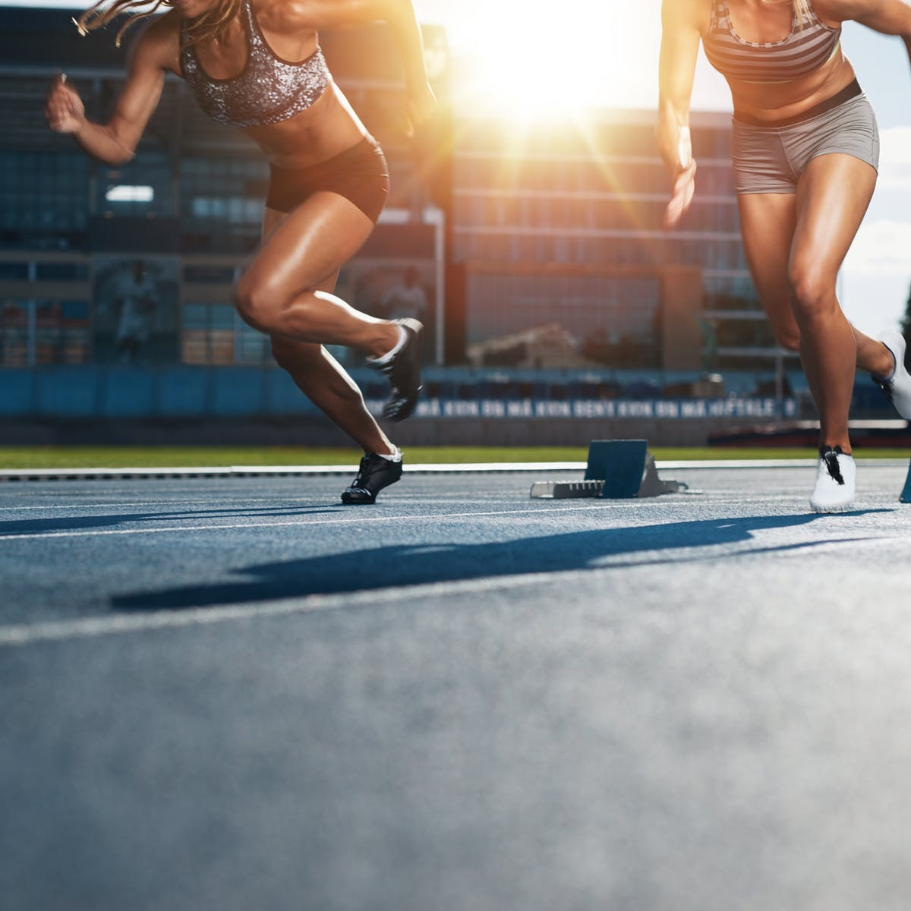
How to encourage and influence females to start including sports in their lives?

Slide 17
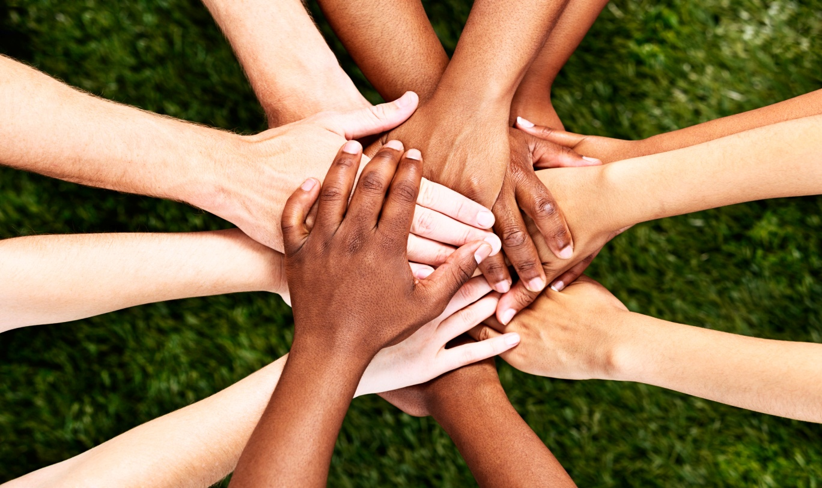
Inform them about…
Possibilities – opening their eyes to what they can do. Inspiring them with real stories they can relate to can help to prime participation.
Togetherness – A friend’s invitation makes sport participation more attractive and there is also greater safety in numbers. Socializing with friends is rewarding and bonding becomes a strong external motivator.

Slide 18
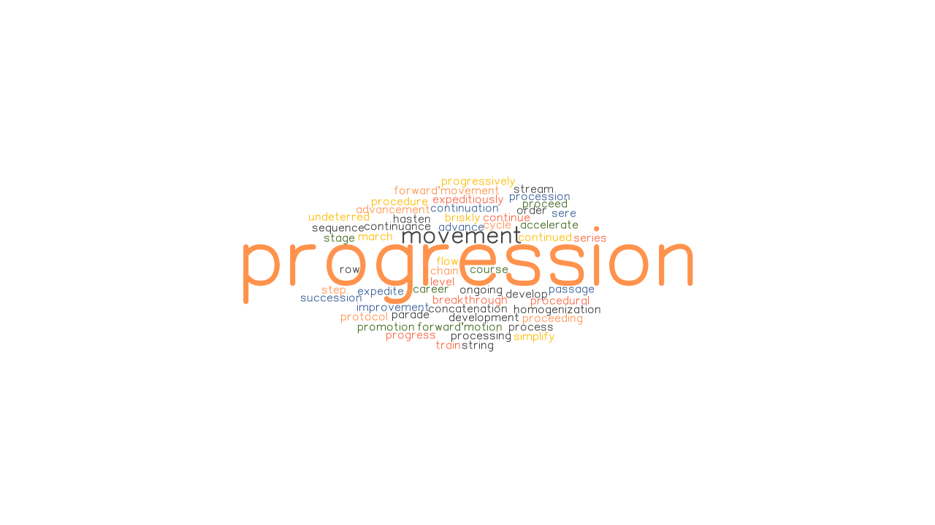
Support – Support from the people in her everyday life (particularly family) is critical to sustained participation.
Progression – Progressive improvement, positive reinforcement and setting realistic goals help sustain participation.

Slide 19
Belonging – Participation in sport is enjoyable and provides an experience worth repeating; personalized contact that underlies respect and recognition.
Internalize – Focusing on feeling good about oneself and the sporting experience, internalizing their own behavioral journey.

Slide 20
MEET OUR TEAM:
Cornelia Chatzigiorgi (A’2)
Emmanouel Mitzelos (A’5)
Nancy Chatziantoniou (A’7)
Tzanos Demirtzis (A’5)

